Slide 1
NDE 3.5
Incremental Steps
Toward Greater Automation in NDE

Slide 2
Agenda
Why NDE 3.5 ? A Case in Point
NDE 3.5: Slightly Better Automation
Small steps – but not half measures
Examples of NDE 3.5 systems

Slide 3
Why NDE 3.5 ?
Hanlon’s Razor*
Do not ascribe to malice, that which is adequately explained by incompetence.
The end results of both malice and incompetence are equally problematic for our goals in NDE.
NDE 3.5 helps to prevent both of these causes.
*aphorism also attributed to Napoleon, David Hume, J.W von Goethe

Slide 4
Why Automate NDE ?
Why strive for NDE 3.5 or even NDE 4.0 ?
Why do NDE at all?
to improve safety
to provide assurance and confidence in quality
to improve manufacturing quality
Prior methods are demonstrably inadequate:
Paper records, images on local disc drives, etc.
No database integration, no integration with manufacturing MRP / ERP
Poor traceability, no true audit capability
NDE 3.5 → NDE 4.0 helps us achieve the core goals of NDE

Slide 5
What is NDE 3.5 ?
NDE 3.0
Digital NDE : C-Scans, image files, etc.
Stand alone inspection systems with local storage of data
NDE not tightly integrated within manufacturing planning and scheduling
NDE 3.5
Existing NDE systems, slightly better integrated
Automation the entire NDE process, not just the scanning part
NDE 4.0
Fully automated NDE, in every conceivable way
Tightly integrated within company and global data ecosystems
Complete fluidity of data, and metadata from NDE systems
Remote management of systems via Digital Twins
Machine Learning, Big Data Analytics,

Slide 6
Evolution of NDE Process Automation
Manual
Scanning
Analysis
Hand held flaw detectors
1.0
New Idea
Scanning
Analysis
Scanning Machines with Stop on Defect
Automated
2.0
Scanning
Recording
Analysis
Strip Charts, C-Scans
3.0
Scanning
Recording
Analysis
Reporting
C-Scans → Image Files, PDF, etc.
Calibration
Alignment
Scanning
Recording
Analysis
Reporting
Archiving
3.5
Calibration
Alignment
Scanning
Recording
Analysis
Reporting
Archiving
Calibration
Alignment
Scanning
Recording
Analysis
Reporting
Archiving
4.0
Materials
Planning
Manufacturing
Logistics
Life Cycle
NDE
Image adapted from: W. Weber, D. Mair, D. Jansen, L. Lombardi , ’Advances in Inspection Automation’ QNDE Proceedings, 2009

Slide 7
How to Approach NDE 3.5 ?
Make better use of existing NDE systems and processes.
1. Automate your NDE Instruments –
most now have:
Setup files – save and recall these versus manual settings
Remote control via TCP/IP, RS-232, etc.
Live data streaming and recording
Scan setups and calibrations can therefore be automated.
Instrument status can be queried remotely.
Data can be stored and shared
2. Integrate the machines used for scanning:
many NDE processes are already mechanized,
these machines stand alone from the manufacturing process
Scanning machines can be connected to the factory network

Slide 8
How to Approach NDE 3.5 ?
3. Use the Factory Database
Modern manufacturing is database driven – why not NDE?
read the barcode - obtain the identity of the item
report that the item is under inspection
setup the scan according to the item type
embed the item identity with the scan data
report NDE results Pass / Fail / Hold
4. Get some integration software
Modern manufacturing is software driven
NDE Instrument software needs remote control
Robot / Machine software needs handshaking beyond simple I/O
An integration platform is needed to connect these sub-systems

Slide 9
NDE 3.5 is All About Metadata
Metadata is information about your inspection data.
It describes the context of how the data was collected.
If the C-Scan is the data, the metadata is the:
instrument and probe identity – serial numbers
identity of the inspected component – lot and serial numbers
last calibration date and result
instrument settings when the data was collected
settings for automated analysis algorithm - amplitude / size criteria
and so on..
Metadata makes possible:
Archiving to databases
auditing with contextual verification
Trending and analysis for process monitoring and control.

Slide 10
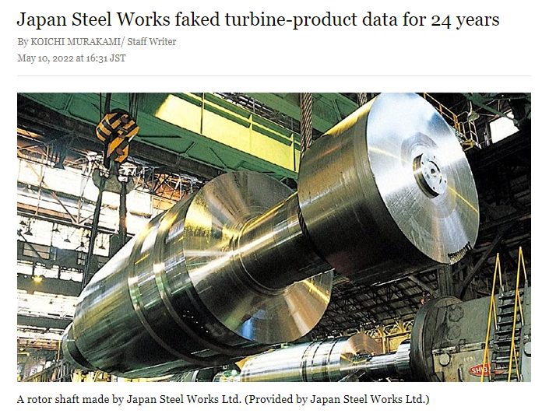
Why NDE 3.5 ?
Preventing this:
NDE connected to factory systems admin systems.
Automated setup from database.
Automated records of process steps.
Automated data storage
Regular external audit via metadata.
Customer access to data
Recognition of NDE importance in long term company.
Ethical Management

Slide 11
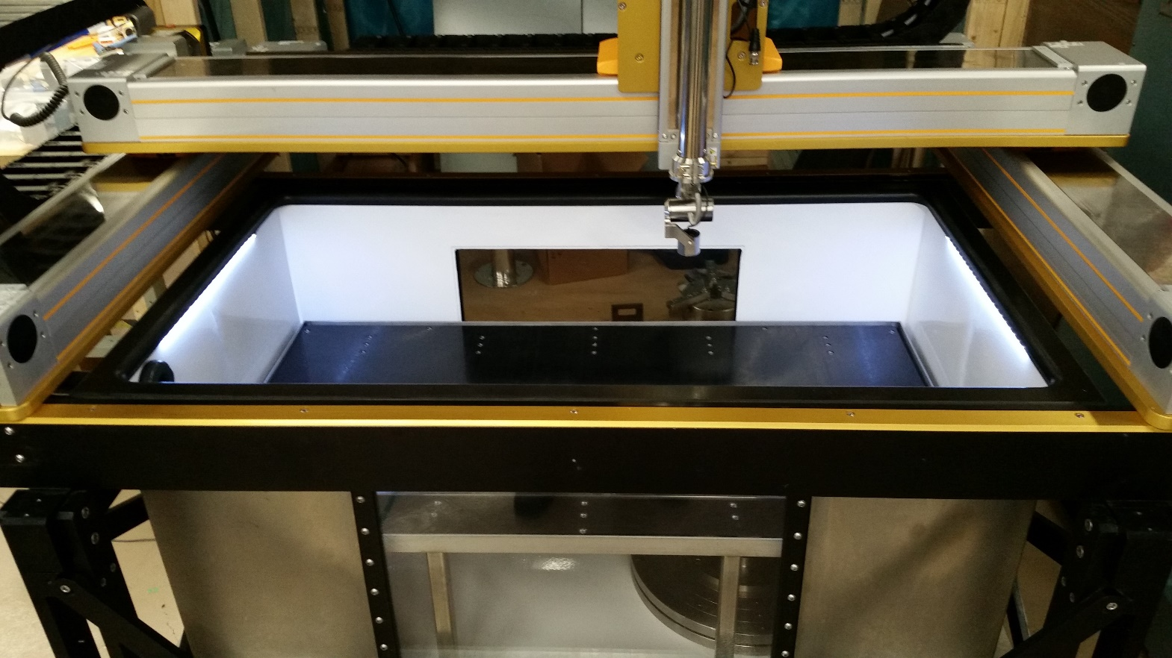
NDE 3.5 in Action – Example 1: Quality for High Performance Steel
SONIX immersion tank circa 1990’s Updated in 2017 with modern software and motion control.
All original functions remain.
New Capabilities:
High speed scanning of test coupons in batch mode.
Automated analysis and decisions
Remote management
Database for setup and reporting

Slide 12
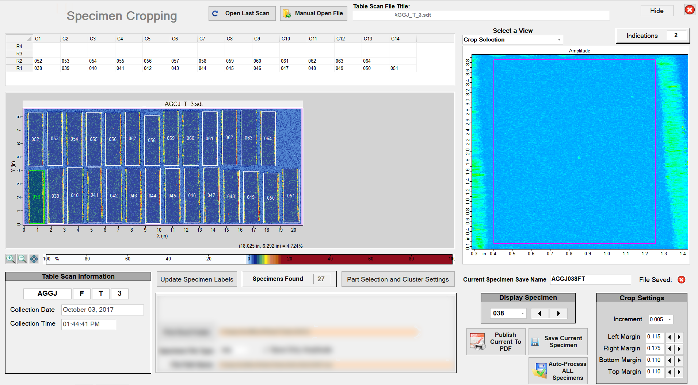
NDE 3.5 in Action – Example 1: Quality for High Performance Steel
Coupons are automatically scanned with high frequency UT, and automatically evaluated.
Several systems globally. All use common settings and report to a central database.
Automated Analysis Software:
Detects individual coupons.
Automated analysis by coupon.
Defect detection and tabulation
Remote management
Database for setup and reporting

Slide 13
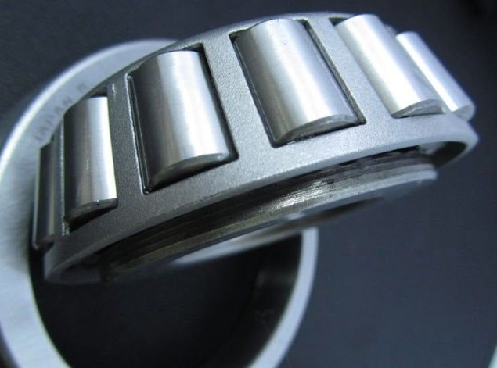
NDE 3.5 in Action – Example 2: High Performance Bearings
High speed automated inspection of bearings includes setup, data acquisition, analysis and decision to Accept / Reject
Inspection of Inner and Outer Rings
High Frequency Ultrasonic
Conventional UT
Inspection Process:
PLC Controlled – fully automated
~ 30 second cycle time
UT setup from database
Batch and Lot numbers included within UT data files
Trending graphs reported to factory

Slide 14
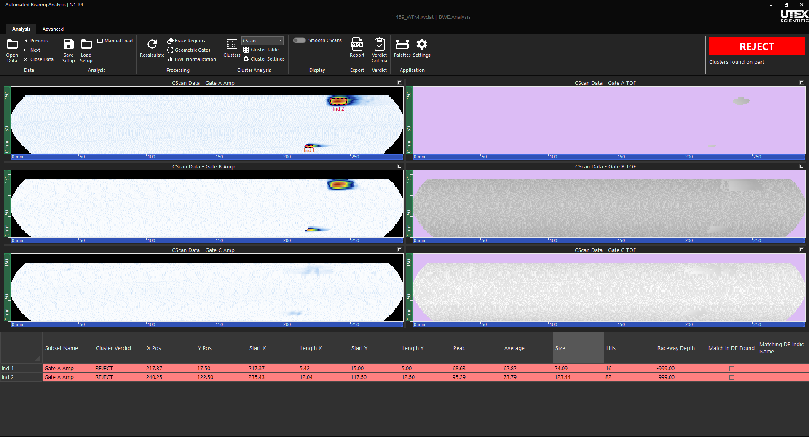
NDE 3.5 in Action – Example 2: High Performance Bearings
Screen from automated system: Operator is not normally present. Bearing is rejected

Slide 15
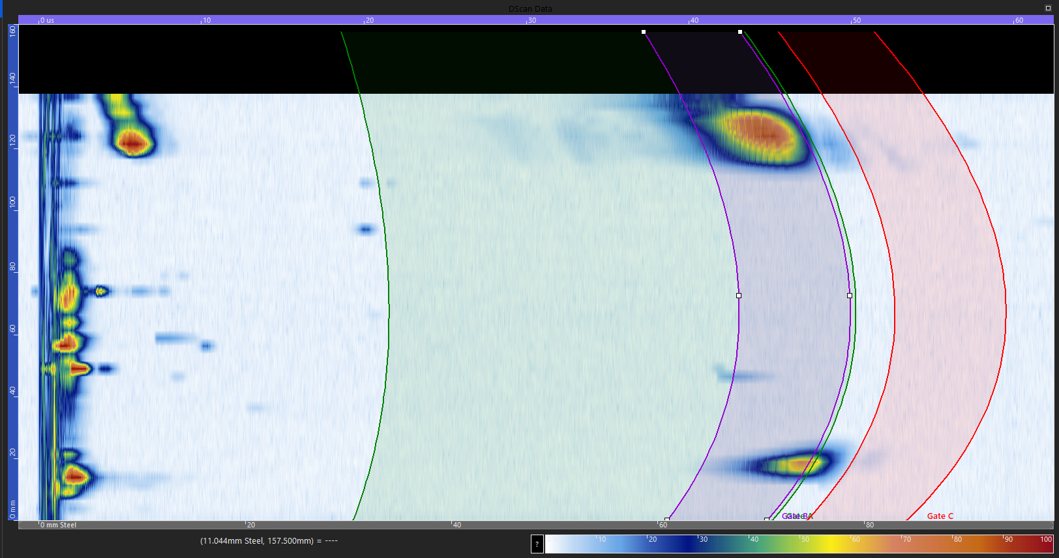
NDE 3.5 in Action – Example 2: High Performance Bearings
Screen of Geometric Gate setup.
Gate settings are saved to database for retrieval during automated mode.
Analysis:
3D Gates - settings from database
Analysis criteria from database
Higher detection spec. in raceways
Automated Accept / Reject sent to PLC
Data saved to cloud for follow-up analysis
Body (core)
Gate
Raceway
Gate

Slide 16
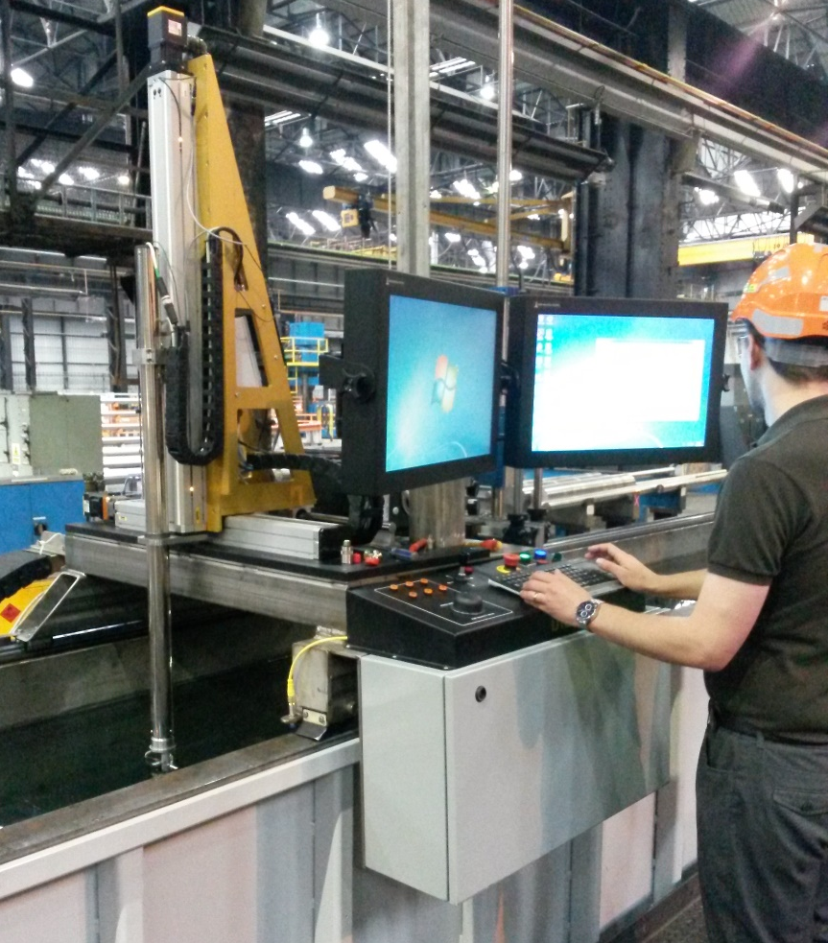
NDE 3.5 in Action – Example 3: Aerospace Metals Billet Inspection
Barcode to query factory MRP database
From factory database:
Setup Requirements – Instruments & Scan settings
Calibration specimen and requirements
Automated Inspection
Calibration & Fitness for Use Reporting
Scanning & data saving with embedded metadata
Turned shafts: all faces scanned in one operation

Slide 17
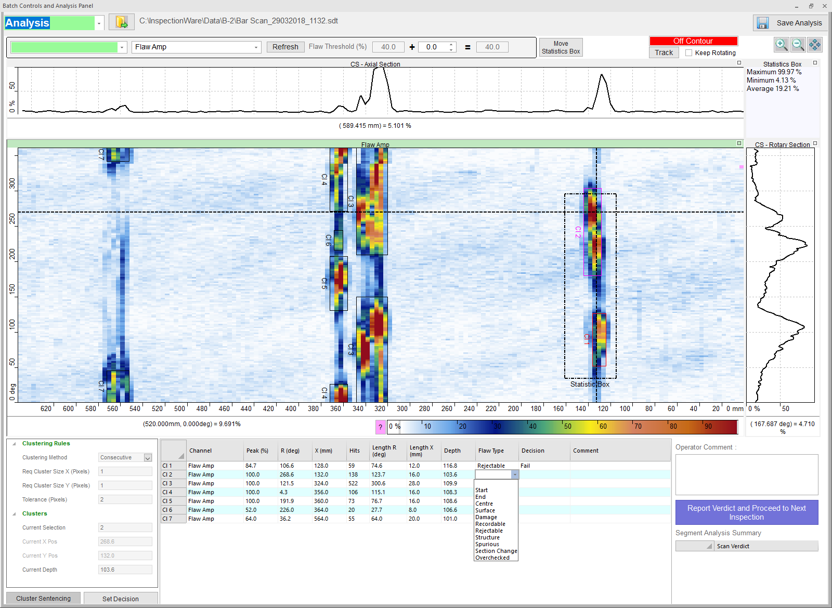
NDE 3.5 in Action – Example 3: Aerospace Metals Billet Inspection
Semi-Automated Analysis
Clusters are automatically detected & tabulated
Human Analyst: classification and judgement
Automated Reporting
1-button upload of all assessments and data files
To factory database
Inspection Status: Completed
Inspection Verdict: Release / Hold for follow-up
Inspection Data Files: C-Scans, tabulated indications,
Inspection Results: PDF report, Excel file (indications tables)

Slide 18
Thank You
www.utex.com
Questions ?
dseto@utex.com

Slide 19
Extras

Slide 20
Industry 4.0
Examples:
Commercial Aircraft and engines
Power Generation Plants
Power Generation Grid
Oil and Gas assets
Real Time Asset Management
Machine
Learning
Apps
In The
Cloud
Big Data
Analytics
Digital Twin
Data In The
Cloud
Remotely
Managed
Asset
IIoT

Slide 21
Industry 4.0
Convergent Technologies:
*IIoT = Industrial Internet of Things
Fully Automated Machines
Local Machine Learning
Digital Twins – Cyber-Physical Systems
Big Data Analytics
Machine Learning (AI)
Convergence and Integration of
Digital Technologies via Networks
Apps
In The
Cloud
Machine
Learning
Digital Twins
Big Data
Analytics
Data In The
Cloud
IIoT*
Automated
Machines
Remotely
Managed
Operation
NDE

