Slide 1
May 17 – 19, 2022
Caesars Windsor, Windsor, Ontario, Canada
Industrial Radiography & Radiograph Interpretation
Bridging the Competency Gap
Contributors
Dr. Aziz U. Rehman
George W. Jaques

Slide 2
Bridging the Competency Gap
Agenda
Challenges
Proposal
Contribution
On-Going Projects
Conclusions
Questions & Answers

Slide 3
Bridging the Competency Gap
Challenges
Application Conformance
Interpretation Variance
Regulatory Compliance
Inspector Subjectivity

Slide 4
Bridging the Competency Gap
Proposal
Reduce the Gap
Provide the Missing Link
Remove the Disconnect
in
Training, Experience and Field Application of Industrial Radiography

Slide 5
Bridging the Competency Gap
Contribution

Slide 6
Bridging the Competency Gap
Contribution
Connection in Training & Application
Increase Compliance with Codes
Improve Interpretation & Disposition
A Ready Reference for day-to-day Use
for
Safe, Reliable and Most Importantly, “Correct” RT Field Application
Notes:
The authors of this handbook with over 40 years of combined industrial radiography field experience, have felt the need to develop a comprehensive text which can serve as a connection between training and application, a bridge between code requirements and correct interpretation, and also a ready reference to guide users in their day-to-day field work when applying their skills in a manner that is safe, reliable, and most importantly, correct.

Slide 7
Bridging the Competency Gap
Contribution
Over 100 Figures & Sketches
Nearly 100 Data Tables
More than 100 RT Techniques
Close to 200 fully Interpreted Films
400+ Certification Questions
a resource to
Educate | Refresh | Revise
Certify | Recertify
Notes:
The handbook is designed with a purposeful scope, covering all levels of inspector competencies, and is configured by taking into consideration all aspects of field industrial radiography (i.e. education & training, qualification & competency, techniques development & application, code compliance & interpretation), and most importantly, will prove to be handy field guide for routine reference.
The Handbook Consists of

Slide 8
Bridging the Competency Gap
Contribution
9 Sections
39 Units
to provide
Structured approach in developing radiographic inspection techniques with a focused understanding on application of different industrial codes with correct interpretations
Notes:
Handbook comprised of 9 Sections with 1 Appendix, 39 Units with Data Units in Appendix
The handbook, a one of its kind, is aimed at both the practical and field aspects of industrial radiography. It is an effort focused on reducing inspector subjectivity and interpretation variances. The main goal is to give readers, novice or experienced, a structured approach in developing radiographic inspection techniques with a focused understanding on application of different industrial codes with correct interpretation. The handbook also provides readers with a side by side comparison of the use and application of different industrial codes, and will educate users in applying sound judgement while using the acceptance criteria.

Slide 9
Bridging the Competency Gap
On-Going Projects
Facebook Page
YouTube Channel
LinkedIn Profile
Twitter Handle
all for
Benefiting RT Community, improving consistency, enhancing interpretation and reducing inspector subjectivity
Notes:
The “A Practical Field Handbook In Industrial Radiography & Radiograph Interpretation”, is not just a single resource, the authors are also working diligently to add additional resources, including, a YouTube Channel, Facebook Page, LinkedIn Profile, Twitter Handle, where the field inspector, local and international can subscribe.

Slide 10
Bridging the Competency Gap
On-Going Projects
Global Data Gathering Project
To gauge the extent of the Knowledge Gap, depending on Education, Training, Certification Level & Geographical Location
https://forms.gle/uWk5zpbTbndSL9JG7
Notes:
RTFI Pro is working on a Global Project, initiated at the beginning at the end of 2020. The project contains 20 radiographs taken from our Book. The link provide that quiz on google.

Slide 11
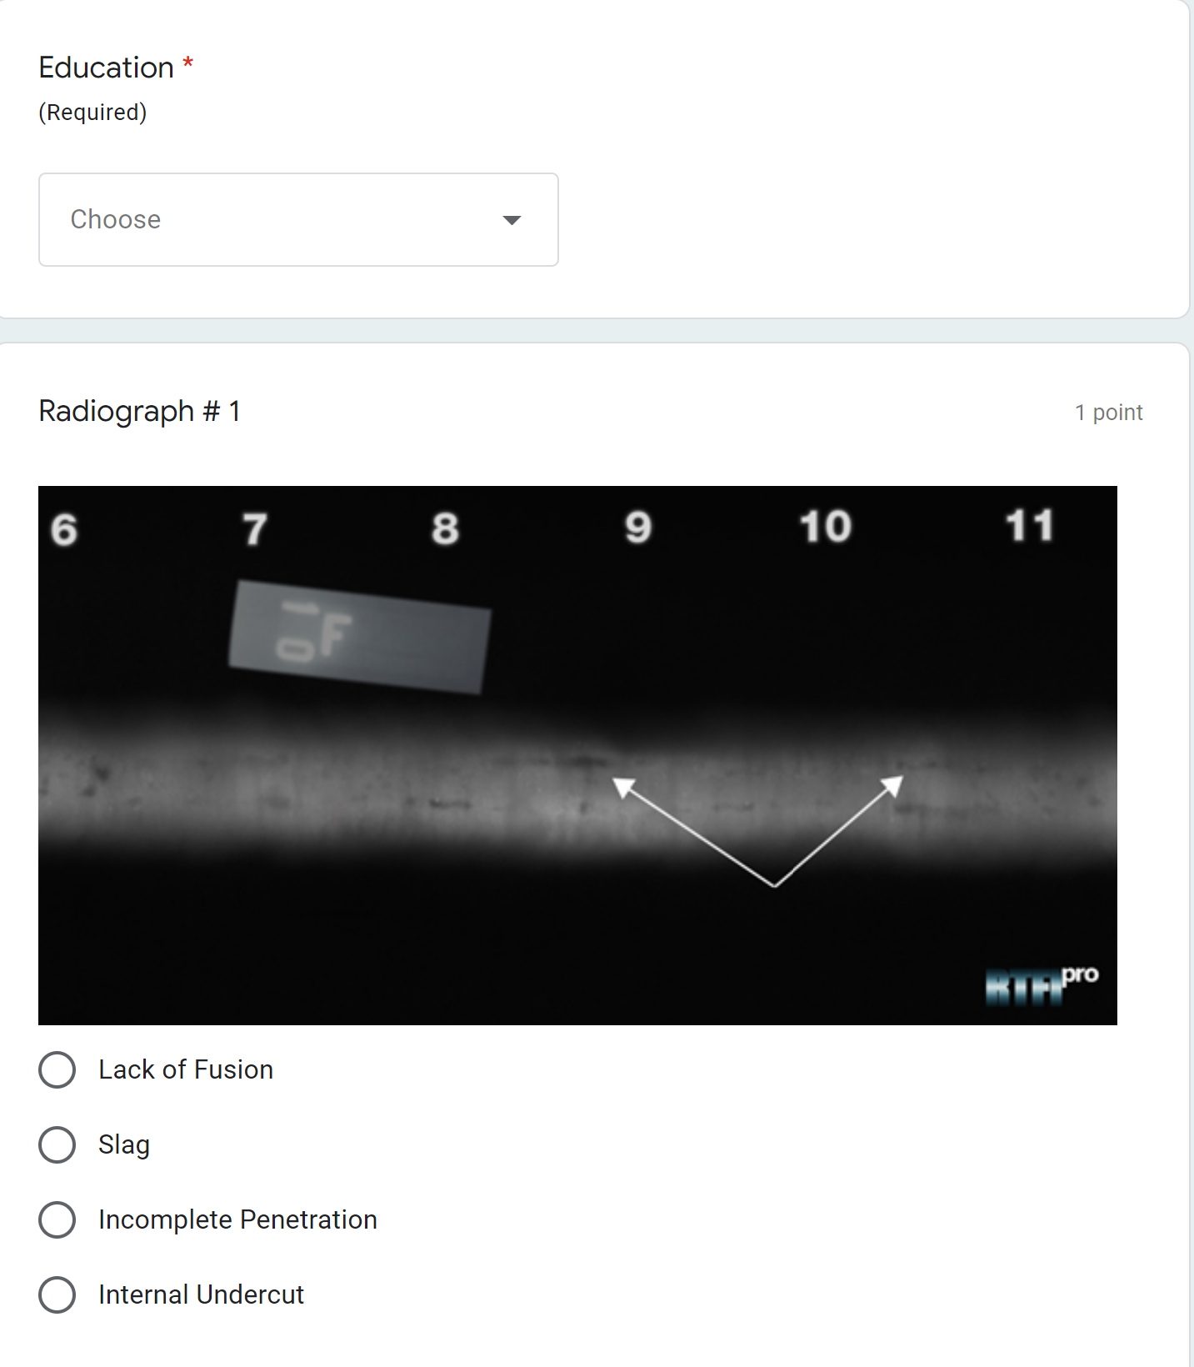
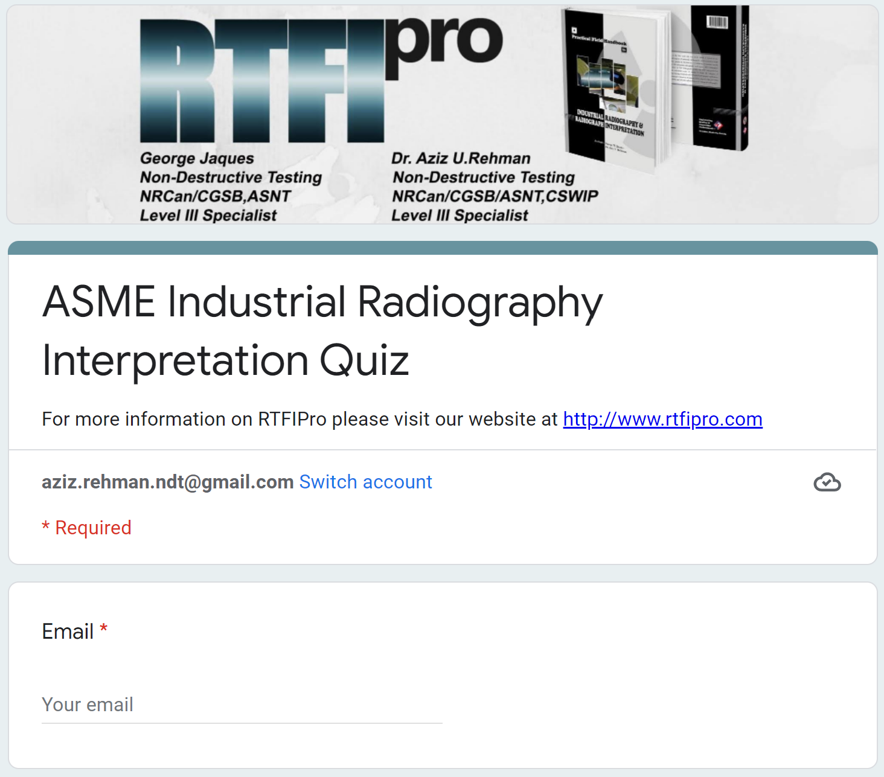
Bridging the Competency Gap
https://forms.gle/uWk5zpbTbndSL9JG7
On-Going Projects
Notes:
The Quiz require the user to submit (voluntarily) the information, [CLICK]
starting with Name, which is optional, [CLICK]
The Email is also options, [CLICK]
Then Country, where the responder need to select an option. [CLICK]
Then Experience, where the responder need to select an option. [CLICK] And finally Education, Training combined with the level of certification [CLICK]
And then 20 Radiographs, where the responders are provided with 4 options to chose from

Slide 12
Bridging the Competency Gap
On-Going Projects
Global Data Gathering Project
Total Response 1,044
Countries 79
Notes:
Some major statistics … There a total of 1,044 responses received from 79 countries. RTFIPro Team is working to analyze the responses to have a better picture of global data analysis

Slide 13
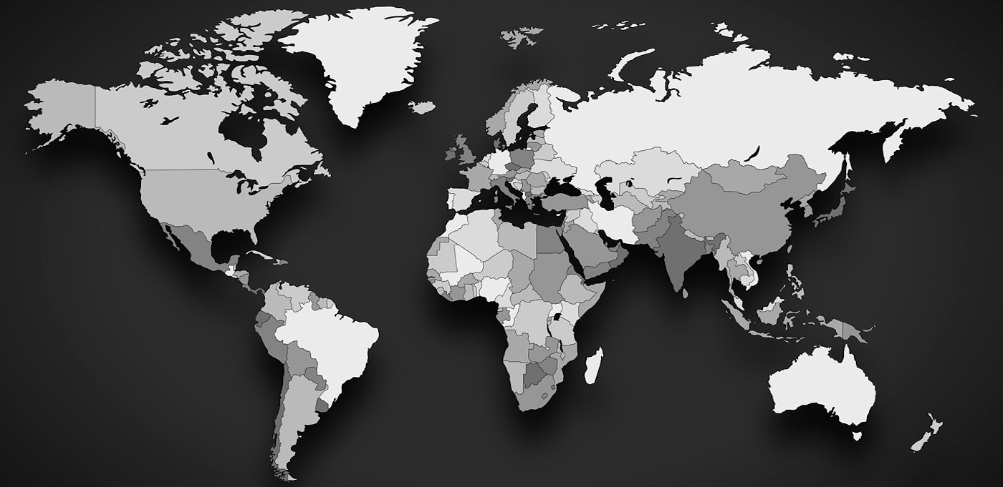
1
3
3
211
1
2
1
30
2
1
3
3
1
4
3
1
4
1
2
80
9
4
4
6
2
3
3
2
1
17
2
3
1
2
4
3
20
3
26
2
6
7
34
3
14
2
4
1
306
3
4
5
1
3
36
1
1
3
1
3
3
1
2
5
11
1
4
1
1
49
1
3
6
1
1
3
18
18
5
2
Notes:
This slide shows a coverage of all responses globally, and the countries from where the radiographs are interpreted.

Slide 14
Bridging the Competency Gap
Experience (Data Extract)
Responses 1006
Correct 606
Experience Data
~ 85 %
< 2 yrs
< 5 yrs
5 – 10 yrs
10 – 15 yrs
15 - 20 yrs
20 - 30 yrs
30+ yrs
Notes:
For a Teaser ONLY
Here is an extract from EXPERIENCE DATA, showing the %age of Correct answers, which is maximum, i.e. 85% for highest experience band
Which is kind of Logical … as there is no replacement for experience.

Slide 15
Bridging the Competency Gap
On-Going Projects
CGSB Committee
ASNT Committee
ASME Committee
eBook
Notes:
In addition, the authors are actively participating in different committees to use Training, Code Knowledge and Experience for making the application of Industrial Radiography uniform, across different geographical regions and different industrial codes & applications. The development of eBook is in final phases, to have easy global availability of our Crosby Medal Winning Handbook. The information about the eBook and subscription links will be available shortly on our website.

Slide 16
Bridging the Competency Gap
Conclusion
The Handbook
is an effort
To guide the users in correct application of Industrial Radiography with an emphasis on practical field aspect
Notes:
This handbook provides readers with some basic understanding in radiation safety, however the main emphasis is to guide the users in correct application of industrial radiography.

Slide 17
Bridging the Competency Gap
Questions
Thank
You
Notes:
This handbook provides readers with some basic understanding in radiation safety, however the main emphasis is to guide the users in correct application of industrial radiography.

