Slide 1
The Effects of Pressure and Bending on Steel Pipe
P.R. Underhill, T.W. Krause, S. Chaudhury
Royal Military College of Canada

Slide 2
2
Outline
Motivation
Background
Experimental Set Up
Results
Conclusions

Slide 3
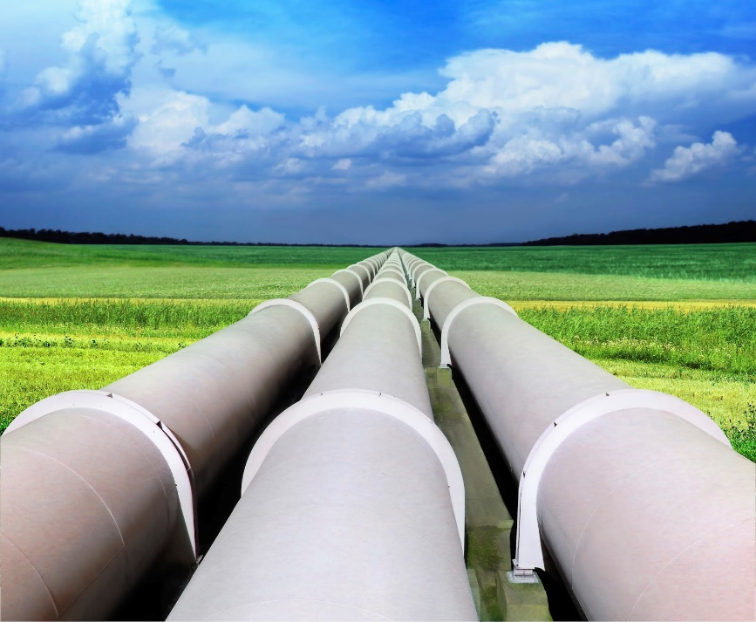
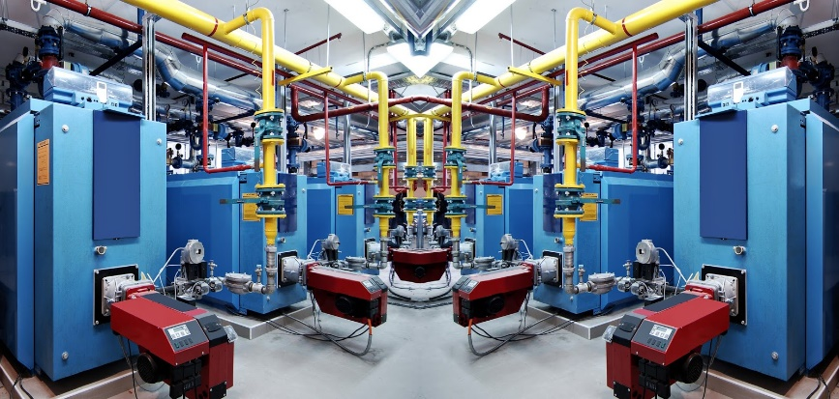
3
Motivation
Magnetic Metal Memory

Slide 4
4
Background
Notes:
Ferromagnetic materials are organized into magnetic domains that are aligned with the <100> directions
Lowest energy state is flux closure.

Slide 5
5
Background
Notes:
Application of an external field causes domains aligned with the field to grow
Application of stress causes growth of domains aligned with stress to grow. domain refinement. Villari effect

Slide 6
6
Background
Pinning prevents domain wall motion
MBN suggests not much domain wall motion below 0.1T
Earth’s field 53 μT in Kingston
Notes:
Application of an external field causes domains aligned with the field to grow
Application of stress causes growth of domains aligned with stress to grow. domain refinement. Villari effect

Slide 7
7
Questions
How can MMM work?
How does the earth’s field interact with steel structures?
How much does stress affect the magnetization of pipes?
How reproducible/quantifiable are the effects?

Slide 8
8
Experiments
 | 1 | 2 | 3
OD (cm) | 3.3 | 3.3 | 9.1
ID (cm) | 2.54 | 2.54 | 8.9
Thickness (mm) t | 3.8 | 3.8 | 5.4
Length (m) | 0.95 | 3.14 | 0.95
Manufacture | extruded | extruded | rolled
Hoop stress (MPA)/ Internal P (ksi) | 27 | 27 | 55
1
2
3

Slide 9
9
Experiments
Z
Y
Tube 3
Scanner
X Axial ± 0.1 μT
Y Radial ± 0.1 μT
Y
Z
Z
Y
Tubes 1 and 2
radial ± 1.06 μT

Slide 10
10
Results – Rotation in Earth’s Field
North
degauss
measure
Degaussed at 0°
Pipe #1

Slide 11
11
Results – Degauss direction
degauss
measure
Pipe #1
Notes:
Pipe degaussed in stated direction but measured

Slide 12
12
Results - Pressurization
Pipe #3
Degaussed in situ

Slide 13
13
Results - Pressurization
Pipe #3
Degaussed in reverse direction

Slide 14
Results – Pressure and Bending
14
4 point bend – Max stress 200 MPa
0
150
200 MPa
Stress
Pipe #2
Degaussed in situ
Notes:
Stress is approximately constant between 100 and 150 cm. Tapers to 0 at 0 cm (end of pipe)

Slide 15
15
Results – Pressure and Bending
Notes:
Although stress at 0 is 0 that is where the biggest change in magnitude occurs

Slide 16
16
Summary
Earth’s field is too weak to act on its own but can produce effects in conjunction with stress and external magnetic fields
The effect of stress depends on the magnetic state of the object being stressed.

Slide 17
17
Summary
Magnetic samples are linked magnetic objects, i.e. an effect can propagate a long way from the impetus
It is very difficult to achieve a reproducible magnetic ground state

Slide 18
18
Outstanding Questions
Why do pipes behave like non-uniform weak magnets?

Slide 19
19
Future Work/Applications
Develop a macroscopic model for large magnetic samples based on microscopic dipoles & pinning
Can we use an induced magnetic state to measure stress history?

Slide 20
20
Questions?

