Slide 1
Correlation between dynamic resistance measurements and real time ultrasonic B-scan inspection for automotive resistance spot weld
Danilo Stocco, Andriy Chertov, Roman Gr. Maev, Sangyun Yoo, Sung Hoon Jung

Slide 2
Outline
Research Subject
Methodology
Experimental studies/results
Conclusions
Future Work
Notes:
Here is the outline of this presentation, where we are going to have
Research Subject
Methodology
Experimental studies/Initial results
Conclusions
Future Work

Slide 3
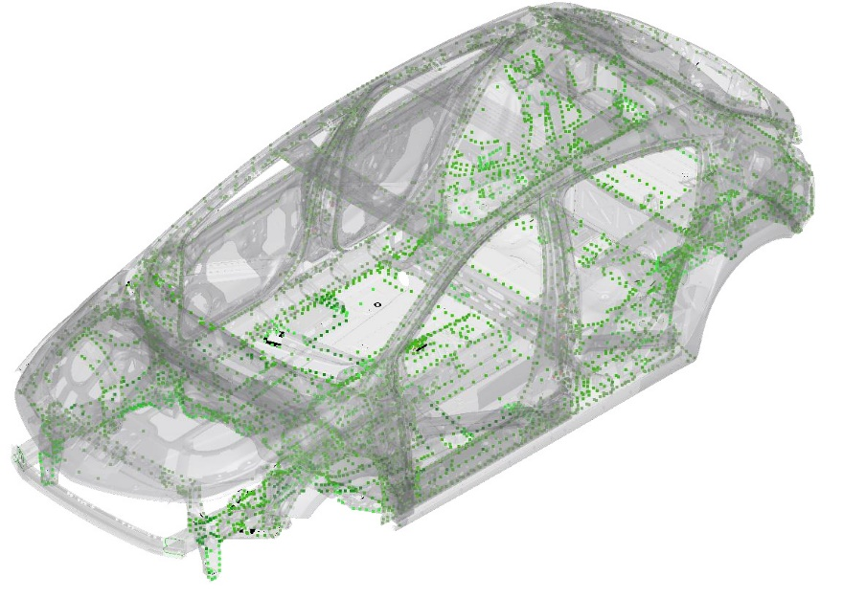
Research Subject - RESISTANCE SPOT WELDING (RSW)
A typical automotive body:
Spot Welds
5000 - 7000
Mig Welds
~5.0 m
Adhesive
~ 90.0 m
Schematics of an automotive body (SAE 2017)
Notes:
Specially for all these characteristics cited, the process is largely used in the automotive industry,
Here is the schematics of an automotive body , and as we can see, the automotive body is comprised of different methods of joining. With a range of 5 to 7 thousand, depending the size of the vehicle, resistance spot weld still answers for at least 50% of the entire body construction as a process, still being the process of major interest in this field.
Just to give a rough estimate A single automotive plant produces daily over 5 000 000 welds
Canada has 8 plants/11 assembly lines, which gives us the dimension of this field nowadays.
Typically, 15-20 % of this whole structure are spots classified as safety/critical to the vehicle performance and safety of the occupants, and this is why it is crucial to ensure a proper process control and monitoring for these welds.

Slide 4
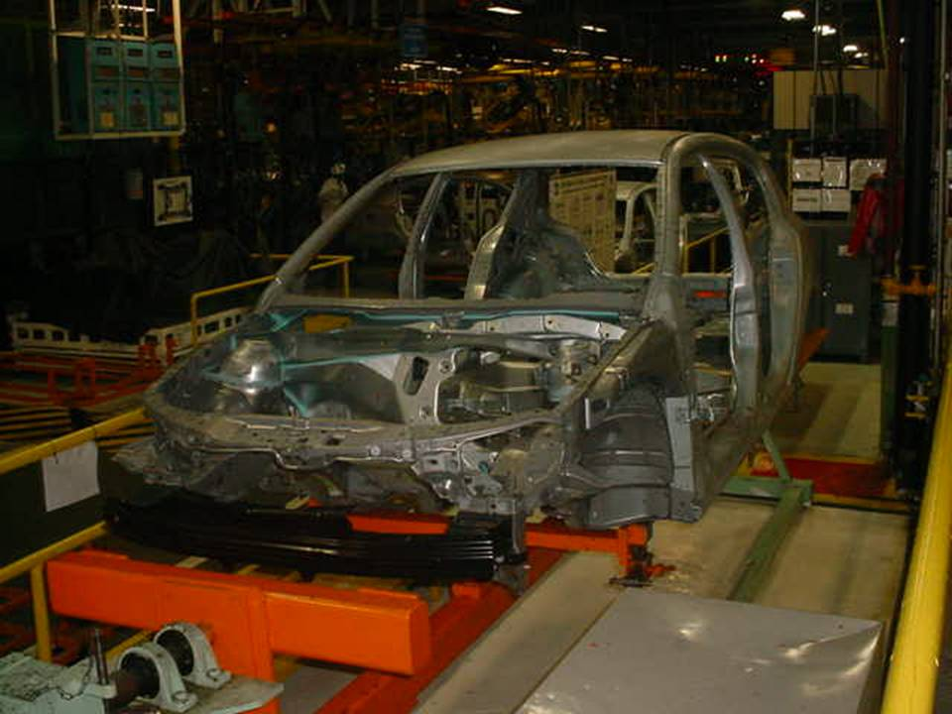
RESISTANCE SPOT WELDING (RSW)
Total weld cycle: 1 second
Highly automated
Steel and Aluminum
A single automotive plant produces daily over 5 000 000 welds
Notes:
The process is one of the fastest in terms of process time, and due to that is prone to a high automation level inside the automotive plants. The process is also capable of joining different types of Steel, and also Aluminum

Slide 5
RESISTANCE SPOT WELDING (RSW)
Contact electrical resistance between the plates (R)
Electrical current passing through the plates (I)
I
Duration time of eletrical current being applied (t)
R
$$Q=\int_{t=t_{0}}^{t=t_{w}}{{I_{w}}^{2}\left(t\right)∗R_{tot}\left(t\right)∗dt}$$
$$R_{tot}\left(t\right)=\sum_{i}{R_{i}(t)}$$
Notes:
The subject of this research is an application designed for a Resistance Spot Welding process. RSW is pressure-based joining process, which depends on the three main variables as described, Resistance, Current and Time.
The heat occurs following the Joule’s law principles.
The process is extremely fast, whereas the
Total weld cycle: 1 second
Highly automated
No material added
Usually applicable to Steel and Aluminum

Slide 6
RESISTANCE SPOT WELDING (RSW)
Contact electrical resistance between the plates (R)
Electrical current passing through the plates (I)
Duration time of eletrical current being applied (t)
$$Q=\int_{t=t_{0}}^{t=t_{w}}{{I_{w}}^{2}\left(t\right)∗R_{tot}\left(t\right)∗dt}$$
$$R_{tot}\left(t\right)=\sum_{i}{R_{i}(t)}$$
Notes:
The subject of this research is an application designed for a Resistance Spot Welding process. RSW is pressure-based joining process, which depends on the three main variables as described, Resistance, Current and Time.
The heat occurs following the Joule’s law principles.
The process is extremely fast, whereas the
Total weld cycle: 1 second
Highly automated
No material added
Usually applicable to Steel and Aluminum

Slide 7
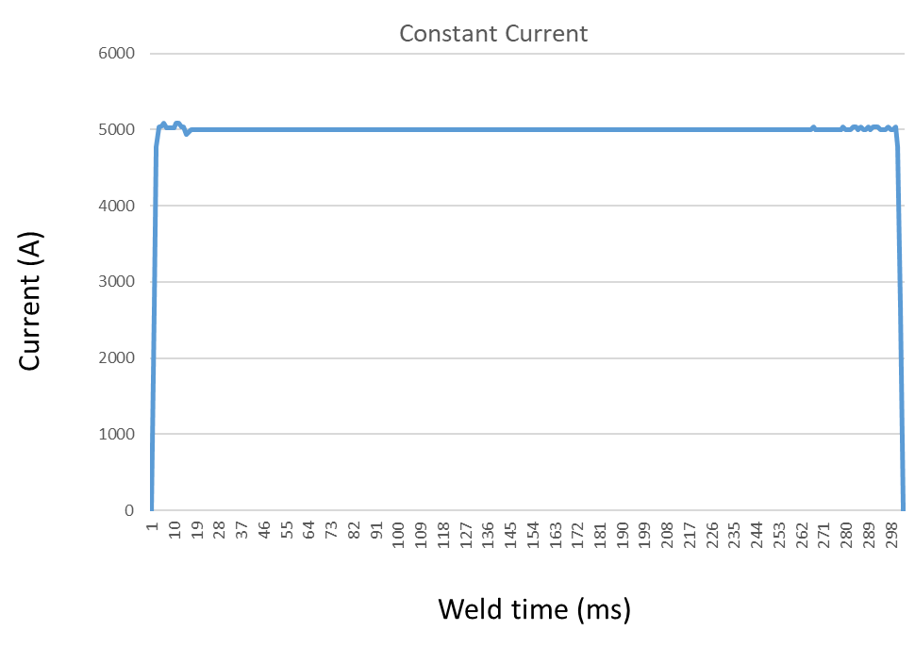
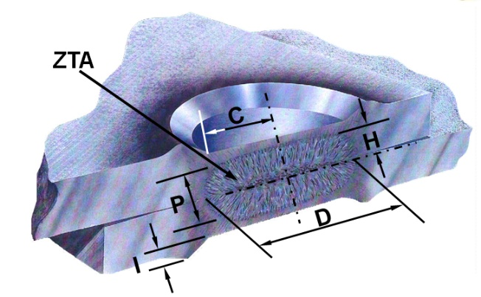
RESISTANCE SPOT WELDING (RSW)
Predetermined Welding schedules;
Modern controllers are capable of regulate the schedule in real time
Schedule 1
Squeeze | 400 ms
Time | 300 ms
Current | 5000 A
Hold | 200 ms
Force | 250 Kgf
Notes:
The subject of this research is an application designed for a Resistance Spot Welding process. RSW is pressure-based joining process, which depends on the three main variables as described, Resistance, Current and Time.
The heat occurs following the Joule’s law principles.
The process is extremely fast, whereas the
Total weld cycle: 1 second
Highly automated
No material added
Usually applicable to Steel and Aluminum

Slide 8
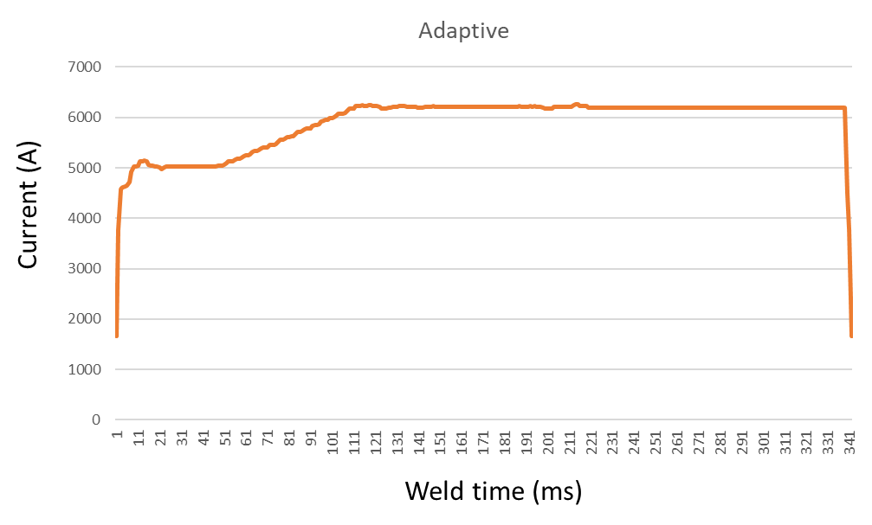
Adaptive welding controllers
- Weld time and Current intensity regulation;
- Designed to adapt the welding to minor variations in the process.
Notes:
Tighten process controls needs to be established;
Use of adaptive welding controllers
Nowadays we have a welding controller capable of regulate Weld time and Current intensity

Slide 9
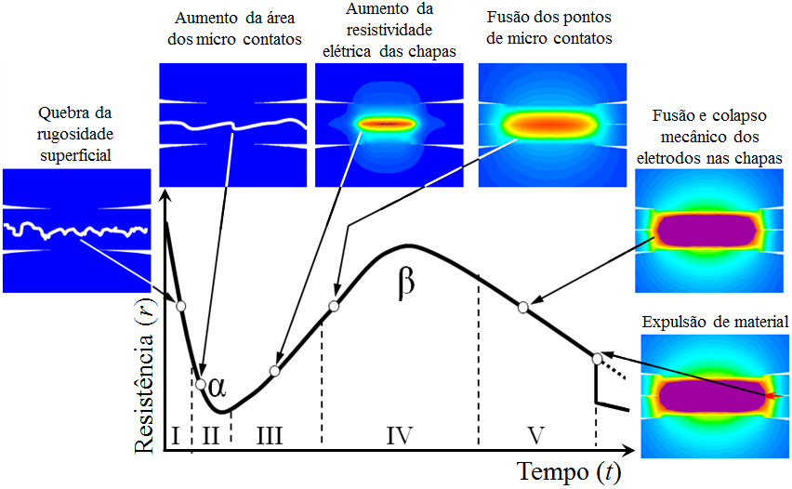
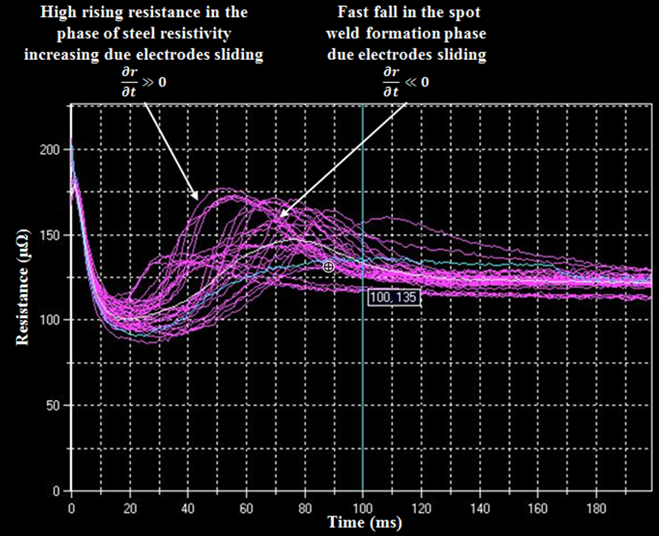
Adaptive welding controllers
Current adaptive welding controllers:
Dynamic resistance measurements of the whole package of the welding setup;
Key characteristics from the dynamic resistance curve behavior are fed back to the weld controller to regulate the welding parameters.
Melting and mechanical collapse of the caps into the plates
Increase of micro contact areas
Initial micro contact melting
Breaking surface asperities
Melting and mechanical collapse of the caps into the plates
Drawbacks:
Expulsion
Indirect measurement;
Subject to multiple variations in the process;
Usually extends total welding time.
Resistance
Time
Notes:
However, these technique presents several drawbacks, for instance the fact that Dynamic resistance measurements takes into consideration the whole package of the joints (including shanks, caps and welding gun arms), and can provide inaccurate measurements.
In addition, resistance measurement is an indirect parameter, which tries to relate with the actual key characteristics of the weld.
Also, tooling conditions have a deep impact in the measurements, leading most of the time to a weld time extension, extremely undesirable to the industry, specially when you need to perform over 5 mi welds/day.

Slide 10
Adaptive welding controllers
Current adaptive welding controllers:
Dynamic resistance measurements of the whole package of the welding setup;
Key characteristics from the dynamic resistance curve behavior are fed back to the weld controller to regulate the welding parameters.
Drawbacks:
Indirect measurement;
Subject to multiple variations in the process;
Usually extends total welding time.
Notes:
However, these technique presents several drawbacks, for instance the fact that Dynamic resistance measurements takes into consideration the whole package of the joints (including shanks, caps and welding gun arms), and can provide inaccurate measurements.
In addition, resistance measurement is an indirect parameter, which tries to relate with the actual key characteristics of the weld.
Also, tooling conditions have a deep impact in the measurements, leading most of the time to a weld time extension, extremely undesirable to the industry, specially when you need to perform over 5 mi welds/day.

Slide 11
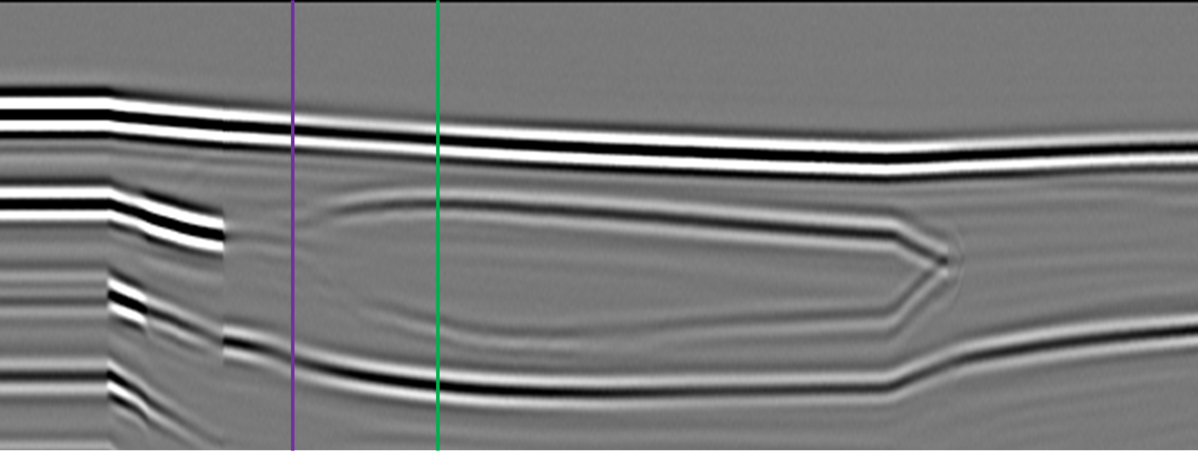
Research Subject
Goal: To identify and compare key characteristics between the dynamic resistance curve, adquired from the welding controller versus the ultrasonic B-scan measurement of the spot weld
Advantages:
Key features extracted from direct measurements;
Less sensitive to process fluctuations;
Full quality assessment records.
Notes:
With this motivation, the goal of this research is to develop an adaptive resistance welding controller device, triggered by an ultrasonic system instead of the actual dynamic resistance methodology.

Slide 12
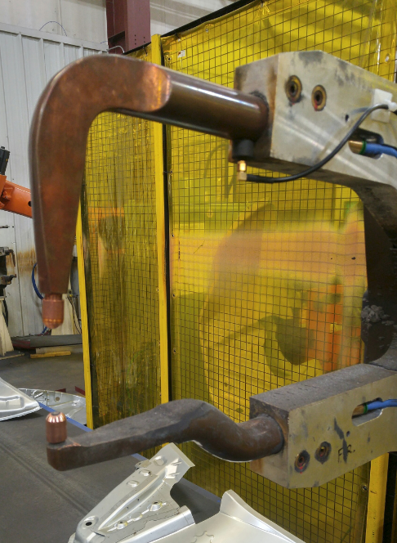
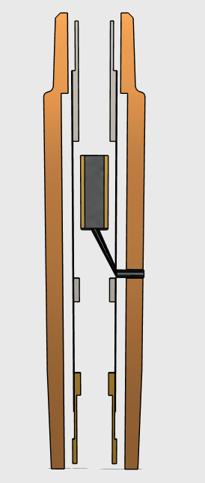
Ultrasonic real time integrated weld analyser system
Ultrasonic wave is sent by the ultrasonic transducer submerged into the cooling water stream. Reflections from the stack boundaries and nugget tell whether the base metal is melted or not.
Pulse echo
12 Mhz
3.0 mm diameter
12
Notes:
For this particular development, it is being utilized the Ultrasonic real time integrated weld analyser system, where an Ultrasonic wave is sent by the ultrasonic transducer submerged into the cooling water stream of the welding gun. The Reflections from the stack boundaries and nugget provide information on the spotweld status.
It uses a Pulse echo transducer with ;
12 Mhz
3.0 mm diameter

Slide 13
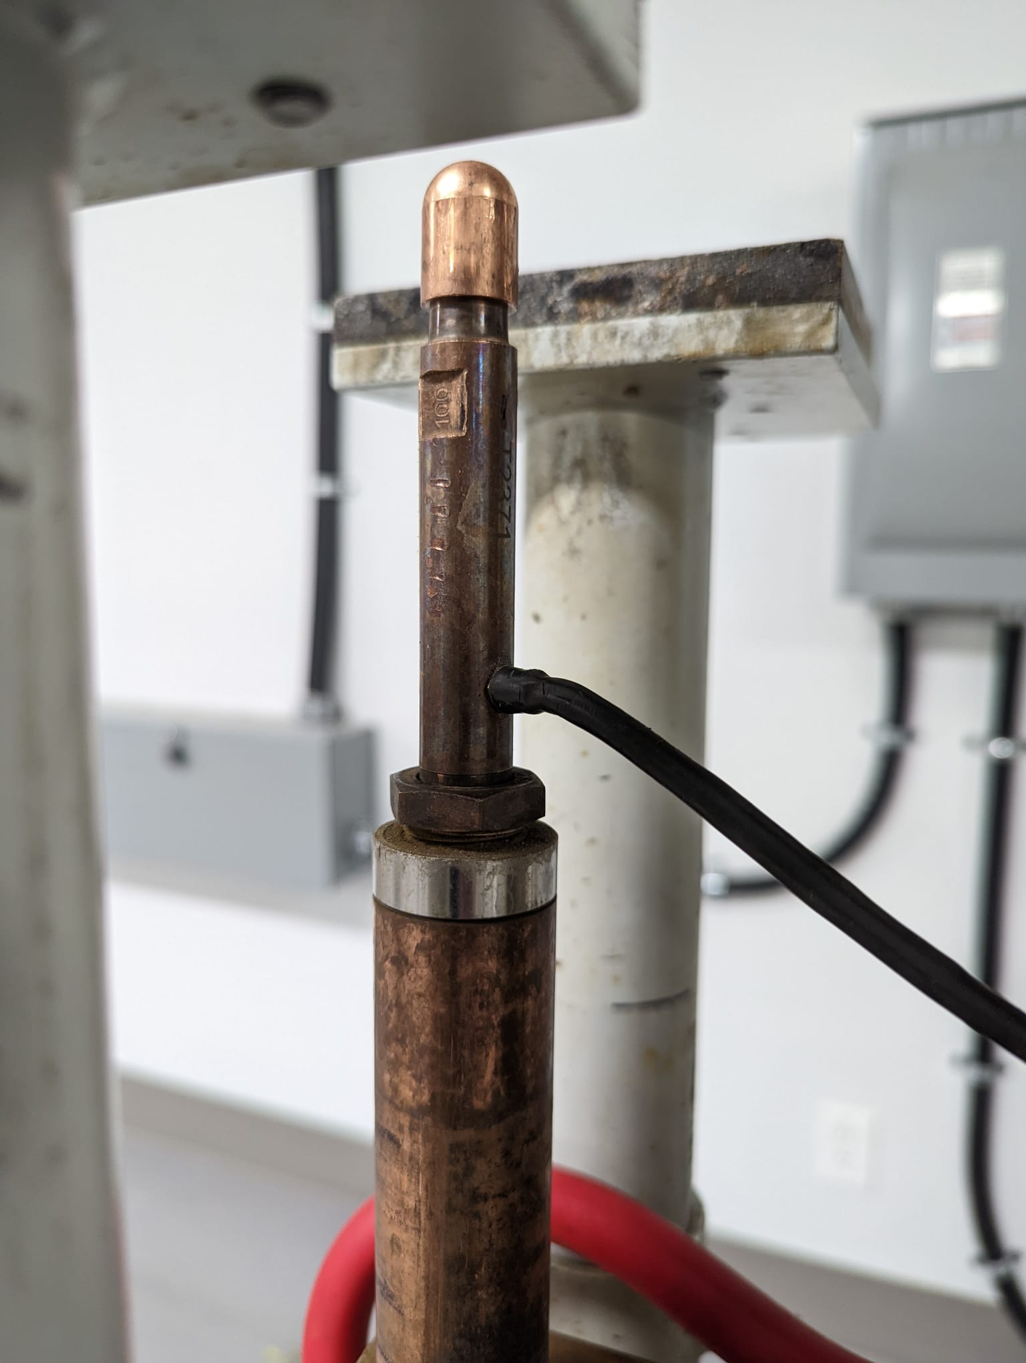
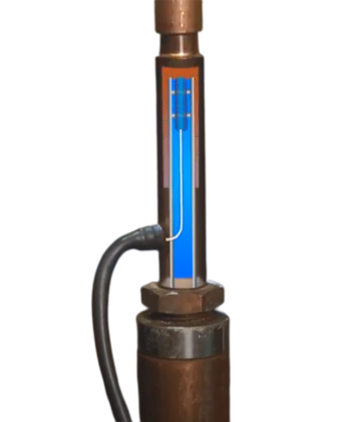
Ultrasonic real time integrated weld analyser system
Ultrasonic wave is sent by the ultrasonic transducer submerged into the cooling water stream. Reflections from the stack boundaries and nugget tell whether the base metal is melted or not.
Pulse echo
12 Mhz
3.0 mm diameter
Water flow to cool electrodes is used as a conducting media for the ultrasonic beam
13
Notes:
For this particular development, it is being utilized the Ultrasonic real time integrated weld analyser system, where an Ultrasonic wave is sent by the ultrasonic transducer submerged into the cooling water stream of the welding gun. The Reflections from the stack boundaries and nugget provide information on the spotweld status.
It uses a Pulse echo transducer with ;
12 Mhz
3.0 mm diameter

Slide 14
Operational principle
Ultrasonic probe built into electrode
1
5
4
Amplitude
PC
Arrival time
Incident wave
Current ON
1
1
Copper Electrode
5
2
Arrival Time
5
Steel Plate 1
Steel Plate 2
4
3
4
Copper Electrode
Welding time
Notes:
Here is a schematic on the system operation, where we can see that the transducer is collecting ultrasonic scans as the welding process progresses. The multiple A-scans combined generate an ultrasonic “acoustic” signature of the RSW.

Slide 15
Operational principle
Ultrasonic probe built into electrode
1
4
2
3
Amplitude
PC
Arrival time
Incident wave
Current ON
1
1
Copper Electrode
2
Arrival Time
2
Steel Plate 1
3
Molten
Nugget
Steel Plate 2
4
3
4
Copper Electrode
Welding time
15
Notes:
It is possible to verify that the method is capable of detecting the interfaces that arise as soon as the molten nugget starts to grow, and this capability will be of interest for the adaptive development.

Slide 16
Ultrasonic B-Scan signature
Weld Time (ms)
COPPER ELECTRODE
Welded sheet thickness
STEEL
PLATE 1
WELDED
PLATES
STEEL
PLATE 2
LIQUID
NUGGET
Time Of Flight (TOF) (μs)
Time Of Flight (TOF) (μs)
COPPER ELECTRODE
Current
Current On
Hold Time
Jaws Open
Current On
Jaws Open
Welding time
Welding time
Notes:
This is the actual ultrasonic B-scan signature, here with its respective representations. Nowadays, we have advanced AI methods to proper identify features in these scans. As shown below, an AI model is being developed to proper identify the key features needed for the adaptive trigger.

Slide 17
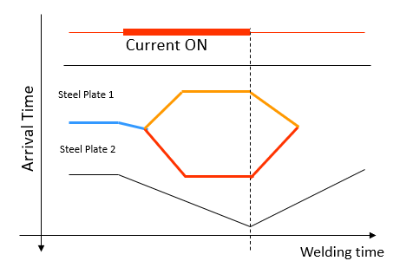
Ultrasonic B-Scan signature
Through ultrasonic signatures, it is possible to identify and determine key features in the whole spot weld process:
- Current ON;
- Melting start;
- Saturation point;
- Expulsions (if any);
- Current OFF;
- Cooling (solidification)
Notes:
Through ultrasonic signatures, it is possible to identify and determine key features in the whole spot weld process:

Slide 18
Ultrasonic B-Scan signature
- Melting Start (SSID)
- Saturation Point (SP)
Notes:
For this development, we will be focusing on two main characteristics: the melting start point and the saturation point, which will be used to trigger the future adaptive algorithm to be developed.

Slide 19
Experimental studies/results
Resistance curve VS B-scan correlation;
Ultrasonic Key event detection capability;
Notes:
Here I will start to show some results already acquired for this research.
Three different experiments were conducted so far, in order to validate the development proposal.
Resistance curve VS B-scan correlation, to establish a correlation between the ultrasonic detected events with the dynamic resistance curve utilized at the moment
Ultrasonic Key event detection capability, checking the ability of the RIWA system to timely identify the events required

Slide 20
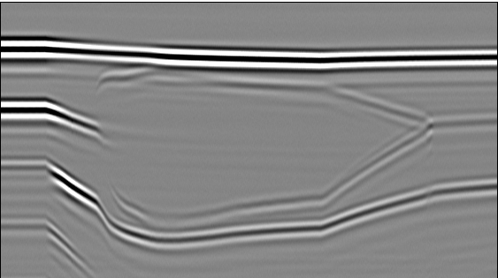
Results - Resistance curve VS B-scan correlation
36 Samples of 1.6-1.6 mm and 30 samples of 0.7-0.7 mm plates, welded with different schedules;
B-Scans were acquired simultaneously with the respective resistance curve for each spot;
Both results were synchronized to look for similarities between them.
Notes:
Initially, I made a correlation test between both characteristics acquired from the US signature vs the dynamic resistance behaviour of the curve.

Slide 21
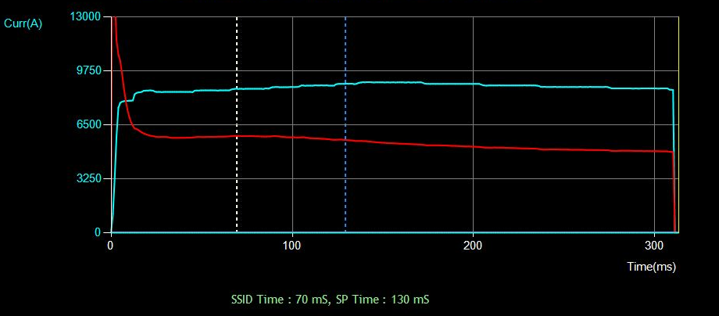
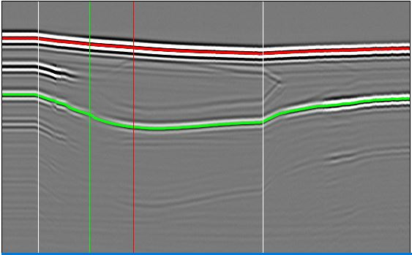
Results - Resistance curve VS B-scan correlation

Slide 22
Results - Resistance curve VS B-scan correlation

Slide 23
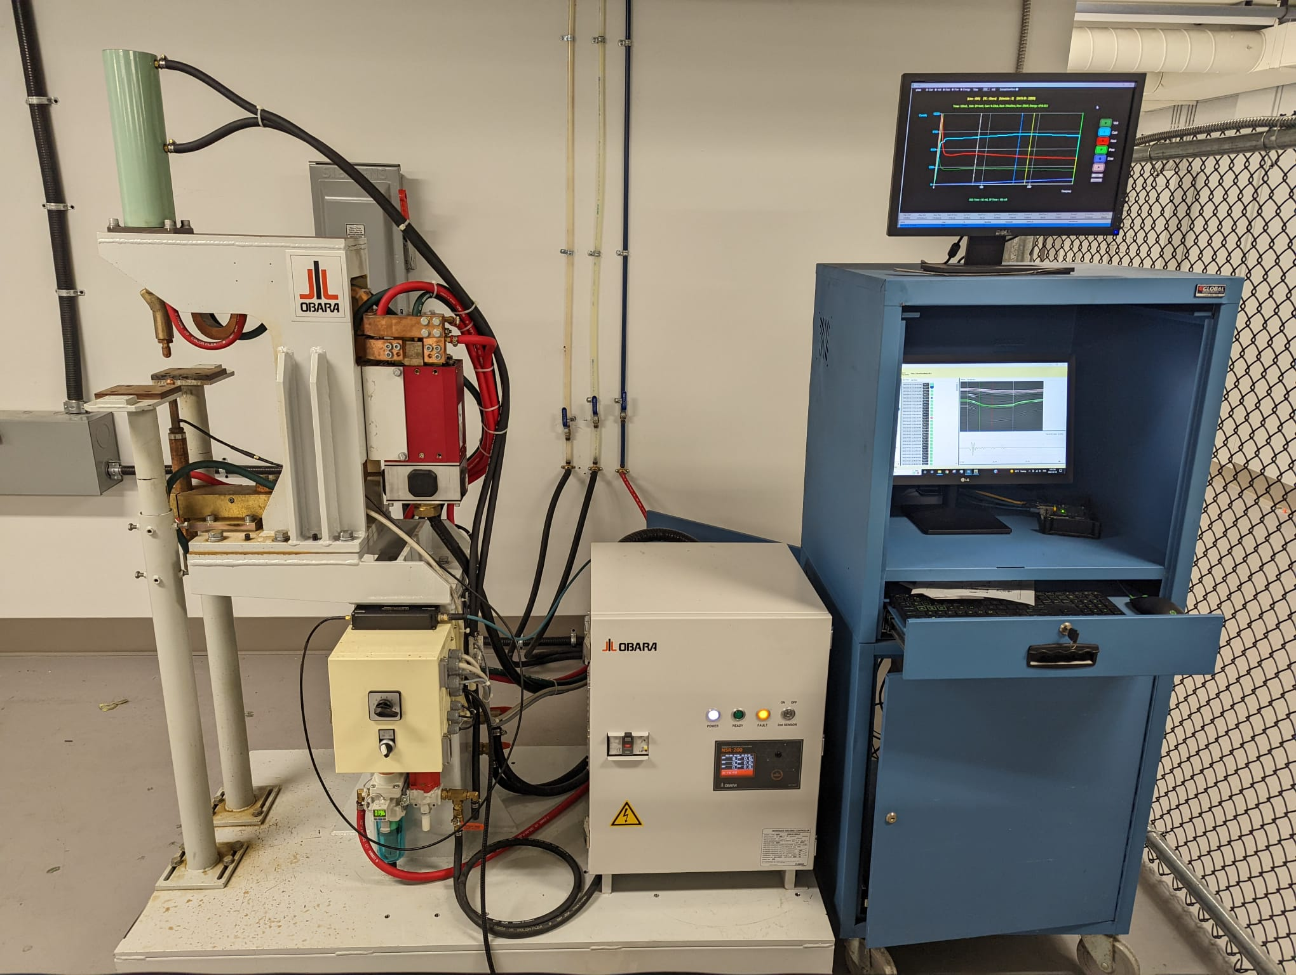
Tools and available resources
MFDC Inverter;
Stationary type C gun;
Obara “Hawkeye” Adaptive Controller;
Pneumatic driven force, proportional valve;
350 KgF max force;
90KVA, 15 kA maximum

Slide 24
Syncronization results

Slide 25
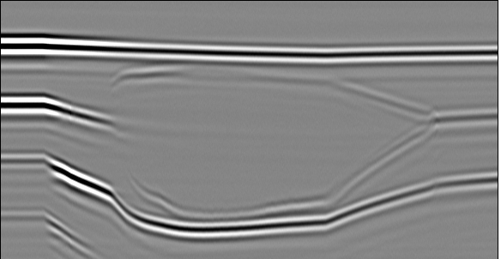
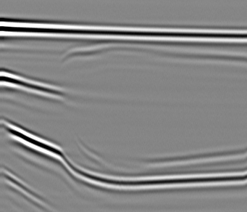
Spot 5
Spot 7

Slide 26
Expulsions

Slide 27
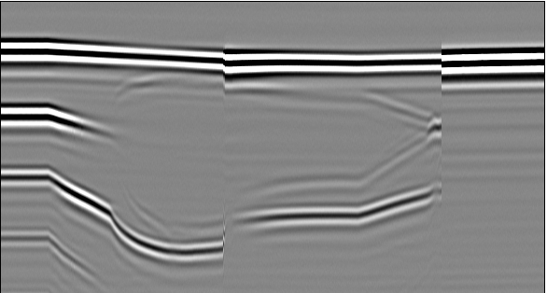
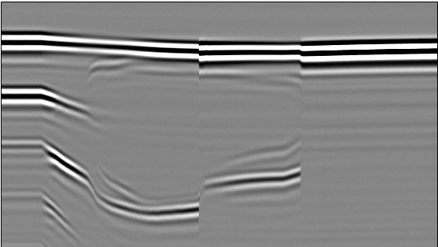
Spot 17
Spot 16

Slide 28
False resistance calls

Slide 29
Spot 13
Spot 12

Slide 30
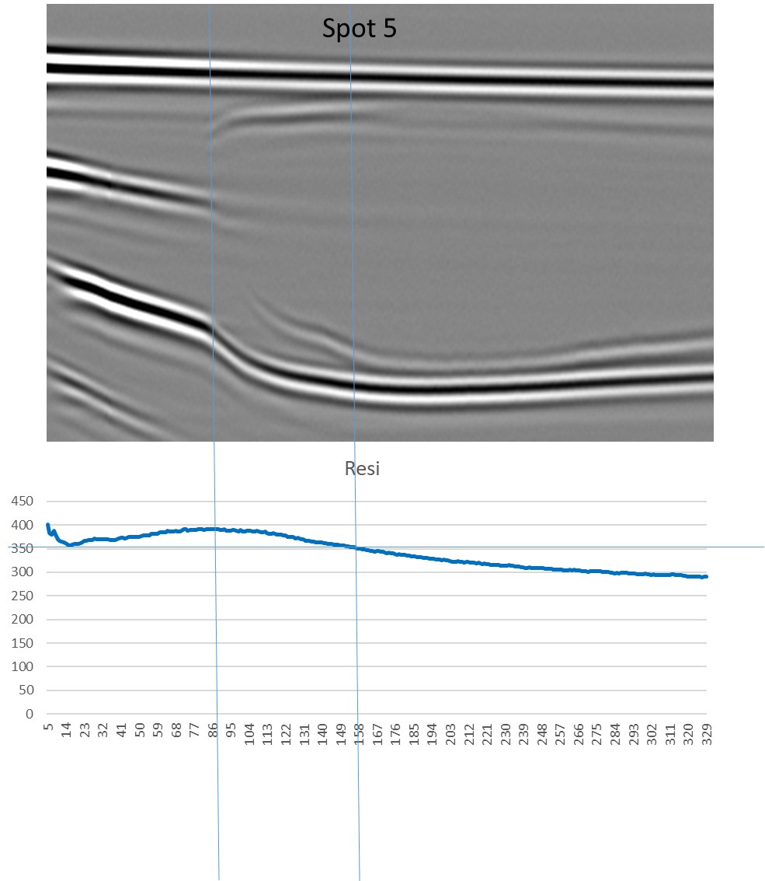
Results - Adaptive curve VS B-scan correlation
Findings
In the studied joints and weld schedules, the resistance peak registered in the curve matches in time with the beginning of melting, as registered by the B-scans collected;
The return of the resistance to its initial lower state show a correlation within the “saturation point” of the vertical nugget growth.
Notes:
Results shown that the , the resistance peak registered in the curve matches in time with the beginning of melting, as registered by the B-scans collected;
Also, the return of the resistance to its initial lower state presents a strong correlation within the “saturation point” of the vertical nugget growth, which confirms that the main signals observed match with the theory.

Slide 31
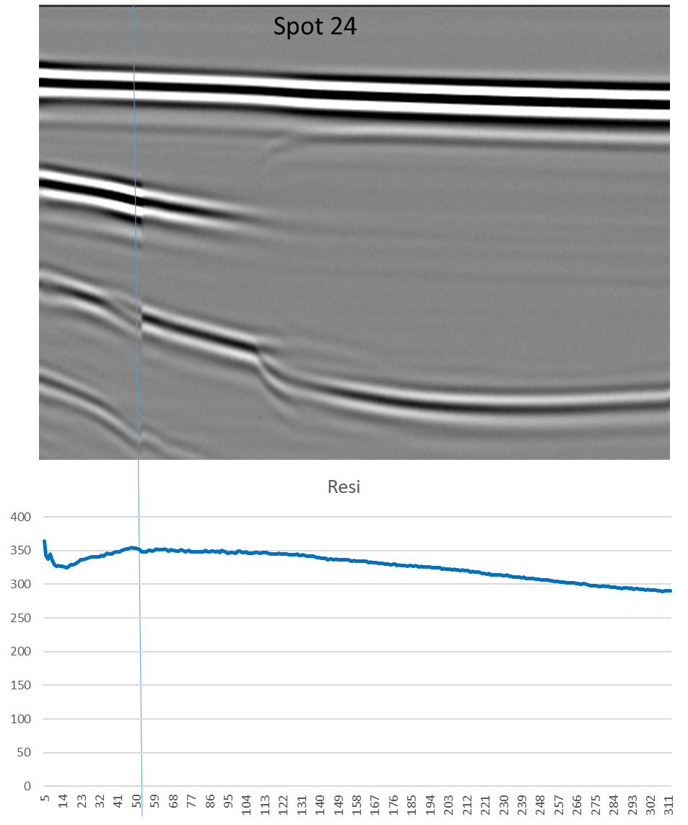
Results - Adaptive curve VS B-scan correlation
Findings
Tooling and contact conditions may affect resistance based adaptive algorithm;
For those specific conditions, B-scan signatures are currently offering an advantage against the existing system.
Notes:
Also, Through this assessment it was possible to notice that in approximately 15% of the cases, Tooling and contact conditions may affect resistance based adaptive algorithm, note that in this particular example there is a mismatch between resistance and ultrasonic scan.
;
For those specific conditions, B-scan signatures are currently offering an advantage against the existing system.

Slide 32
Experimental procedure – Melting start and saturation point events
Saturation point – 125 ms after CON
Initial B-scan @350 ms – sample B1
Melting start – 70 ms after CON
Notes:
After beginning of melting, nugget rapidly grows in the vertical direction (towards the electrodes).
Nugget reaches a “saturation point” towards this direction, and as the time elapses, nugget growth rapidly decreases its growth rate, advancing manly in the horizontal axis.
Mathematical models estimate that the growth rate of the nugget is sharply decreased when the nugget reaches its saturation vertically (Zhou, 2014)

Slide 33
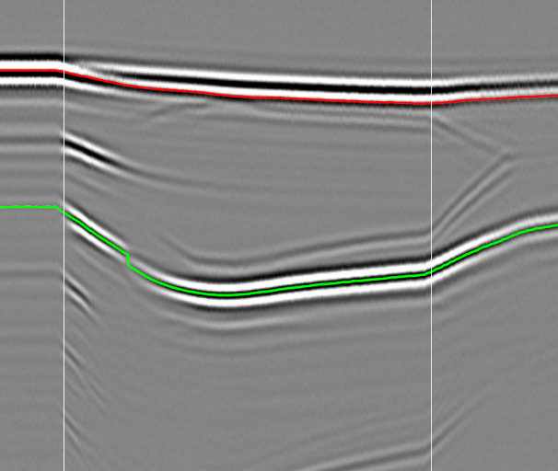
Results – Key event detection
Time
In-process weld characterization (regression)
Identifies key events throughout weld process
Real-time key event detection (SSID, saturation, expulsion);
Ultrasonic A-scans sampled every 1ms
AI conducts inference in ~0.5ms per A-scan
Key features to determine quality: liquid formation point, steel-steel interface disappearance point, nugget saturation point, vertical size of nugget as proportion of stack.
Number of welding samples in this trial was 200. Initial welding current used in the trial was 6kA.
Arrival Time
Notes:
The second verification was performed to verify the capability of the newly designed AI model to identify properly and timely the key events needed. In order to achieve this goal, a new AI model had to be developed, utilizing the regression approach, where slices of the acoustic signature were analysed in separate pieces.

Slide 34
Results – Key event detection
Time
In-process weld characterization (regression)
Identifies key events throughout weld process
Real-time key event detection (SSID, saturation, expulsion);
Ultrasonic A-scans sampled every 1ms
AI conducts inference in ~0.5ms per A-scan
Key features to determine quality: liquid formation point, steel-steel interface disappearance point, nugget saturation point, vertical size of nugget as proportion of stack.
Number of welding samples in this trial was 200. Initial welding current used in the trial was 6kA.
Arrival Time
Notes:
The second verification was performed to verify the capability of the newly designed AI model to identify properly and timely the key events needed. In order to achieve this goal, a new AI model had to be developed, utilizing the regression approach, where slices of the acoustic signature were analysed in separate pieces.

Slide 35
Results – Key event detection
Time
In-process weld characterization (regression)
Identifies key events throughout weld process
Real-time key event detection (SSID, saturation, expulsion);
Ultrasonic A-scans sampled every 1ms
AI conducts inference in ~0.5ms per A-scan
Key features to determine quality: liquid formation point, steel-steel interface disappearance point, nugget saturation point, vertical size of nugget as proportion of stack.
Number of welding samples in this trial was 200. Initial welding current used in the trial was 6kA.
Arrival Time
Notes:
The second verification was performed to verify the capability of the newly designed AI model to identify properly and timely the key events needed. In order to achieve this goal, a new AI model had to be developed, utilizing the regression approach, where slices of the acoustic signature were analysed in separate pieces.

Slide 36
Results – Key event detection
Time
In-process weld characterization (regression)
Identifies key events throughout weld process
Real-time key event detection (SSID, saturation, expulsion);
Ultrasonic A-scans sampled every 1ms
AI conducts inference in ~0.5ms per A-scan
Key features to determine quality: liquid formation point, steel-steel interface disappearance point, nugget saturation point, vertical size of nugget as proportion of stack.
Number of welding samples in this trial was 200. Initial welding current used in the trial was 6kA.
Arrival Time
Notes:
The second verification was performed to verify the capability of the newly designed AI model to identify properly and timely the key events needed. In order to achieve this goal, a new AI model had to be developed, utilizing the regression approach, where slices of the acoustic signature were analysed in separate pieces.

Slide 37
Results – Key event detection
Research Track : Real-time Key Event Detection
Results: SSID True Positive Rates
-within 10ms of expected: SSID: 92.5%
Saturation event : ≥ 93%
Total processing time ≤ 0.6 ms
Notes:
Currently our database has over 48000 welds, with different welding schedules and stack thicknesses. Over 22000 welds were labeled for AI training
Interesting fact is that as the scans are acquired in real time, there is no way to “store” samples for later checkups/retests.

Slide 38
Conclusions
It was possible to determine a strong correlation between resistance curve peak vs B-scan indication of melting start;
Some correlation were detected between resistance drop curve and the vertical growth “saturation point” of the nugget. Further investigation will be conduct on these findings;
Tooling conditions strongly affect results, especially the false resistance calls assessment. Some adjustments are still needed in order to approximate the lab conditions to the real production environment schedules;

Slide 39
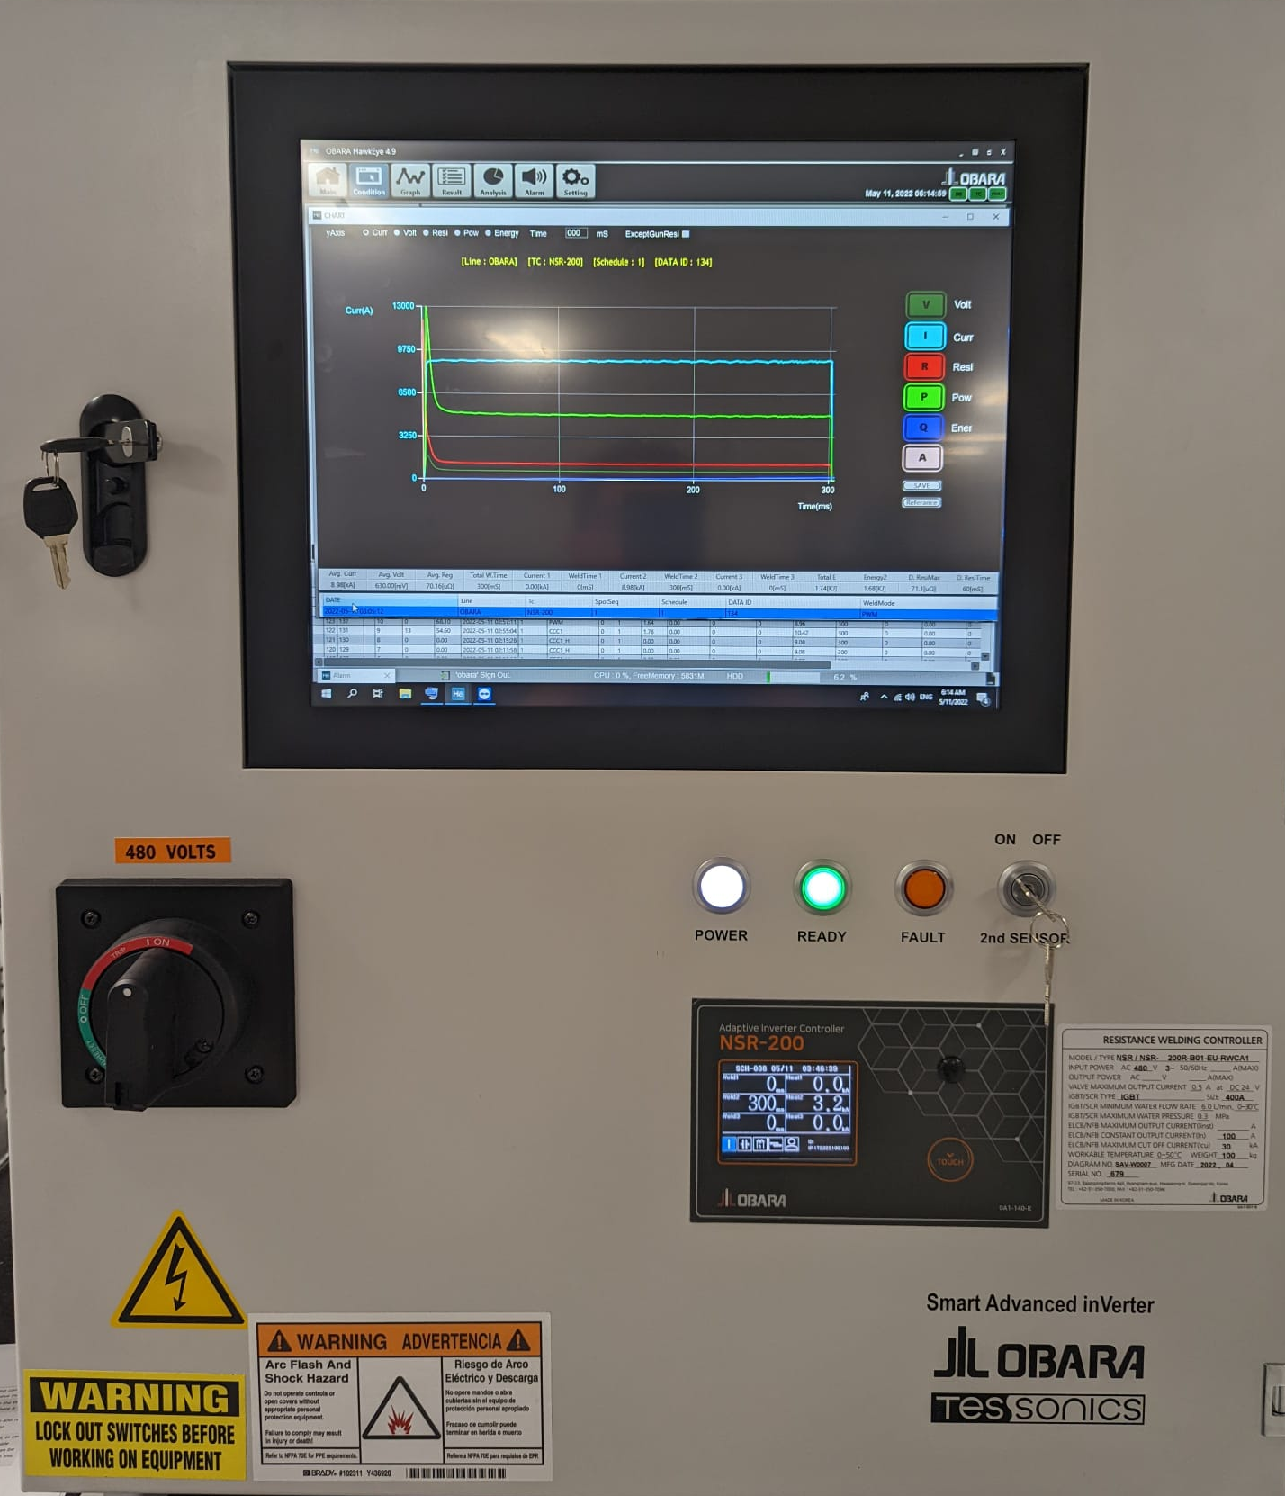
Conclusions
Initial results on the event detection rate and processing times validate the application of the ultrasonic real time in an adaptive application;
Prototype system is fully developed, current on the testing phase;
The study also demonstrates a potential on reducing the weld time, and consequently the cycle time of production lines, in some cases with reductions of 50 % of the total weld cycle.
Notes:
Initial results on the event detection rate and processing times validate the application of the ultrasonic real time in an adaptive application – signal processing with the existing model is under 0.6ms, which allows the system to timely provide a feedback for each single scan;

Slide 40
Future work
Test additional plates combination and materials to check pattern repetition (3T, Dissimilar thicknesses, Thick plates);
Check latency in communication between ultrasonic system and welding controller;
Study the effect of the weld current intensity, and the distance between Melting and Saturation events;
Testing the novel design schematics for the existing adaptive algorithm (prediction of welding time reduction/current OFF after SP identification plus delta time).

Slide 41
Acknowledgements
Thanks!

Slide 42
References
Ultrasonic In-Process Monitoring And Feedback Of Resistance Spot Weld Quality. Patent application by R.Gr. Maev and A.M. Chertov. Attorney Docket No. 706940US1
Transducer built into an electrode by Maev et al. US Patent 6297467
FURLANETTO, V., Desenvolvimento e instrumentação de um cabeçote de solda a ponto por resistência elétrica para aplicação em condições industriais. PhD Thesis - São Paulo, 2014.280 p (in Portuguese)
WANG S. C., WEI P. S., Modeling Dynamic Electrical Resistance During Resistance Spot Welding, Transactions of the ASME, Vol. 123, 2001.
WU, T. H., HO J. E., LAN I., WEI P. S., Dynamic Electrical Resistance Effects in Resistance Spot Welding, IMPACT Paper code:TW042-1, 2013.
CHO Y., KIM Y., RHEE S., Primary Circuit Dynamic Resistance Monitoring and its Application to Quality Estimation during Resistance Spot Welding, Supplement to The Welding Journal, 2002.

Slide 43
References
ZHANG H., SENKARA J., Resistance Welding: Fundamentals and Applications, Second Edition,CRC Press, 2012.
FONSECA E. O. T., BRACARENSE A. Q., Desenvolvimento de um Sistema para Monitoração da Resistência Dinâmica e da Força na Soldagem a Ponto por Resistência Elétrica, XXV Encontro Nacional de Tecnologia da Soldagem, 1999, Curitiba.
GALLER M., ERNST W., VALLANT R., ENZINGER N., New Method for Measuring the Electrical Contact Resistance Spot Welding, Institute of Materials Science and Welding, Graz University of Technology, 2013.
SUN T. A. M. A., Fundamental Study of Contact Resistance Behavior in RSW Aluminum, Thesis Doctor of Philosophy in the Graduate School of The Ohio State University, EUA, 2003.
DW Dickinson, JE Franklin, A Stanya, Characterization of spot-welding behavior by dynamic electrical parameter monitoring, AWS Welding Journal, 1980

Slide 44
Thank you for your attention!
Danilo Stocco
stoccod@uwindsor.ca

