Slide 1
Towards a Practical Pulsed Eddy Current Inspection of Fasteners on Aircraft
P.R. Underhill, T.W. Krause
Royal Military College of Canada

Slide 2
2
Outline
PEC Measurement
Practical Issues
Technical Issues
Small signal in big scatter
Cluster Analysis
Summary/Future Work

Slide 3
3
Why PEC?
No need to Remove Fasteners
Fast (3 seconds/measurement)

Slide 4
4
PEC Measurement
Convert Raw Data to Scores Using MPCA
Take Physical Measurement
Cluster Analysis
Check for Consistency

Slide 5
5
Cluster Analysis
Cluster
ANN
Post Analysis | Post or Immediate
Requires a minimum number of measurements | Once trained can operate on single measurements
blind | Requires Training
No Calibration | Requires Calibration

Slide 6
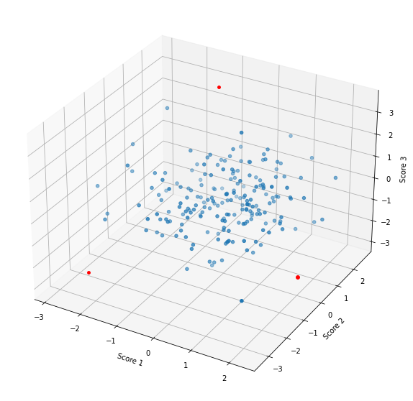
6
Cluster Analysis
Mahalnobis Distance
Need to know centroid and covariance matrix
Robust Statistics

Slide 7
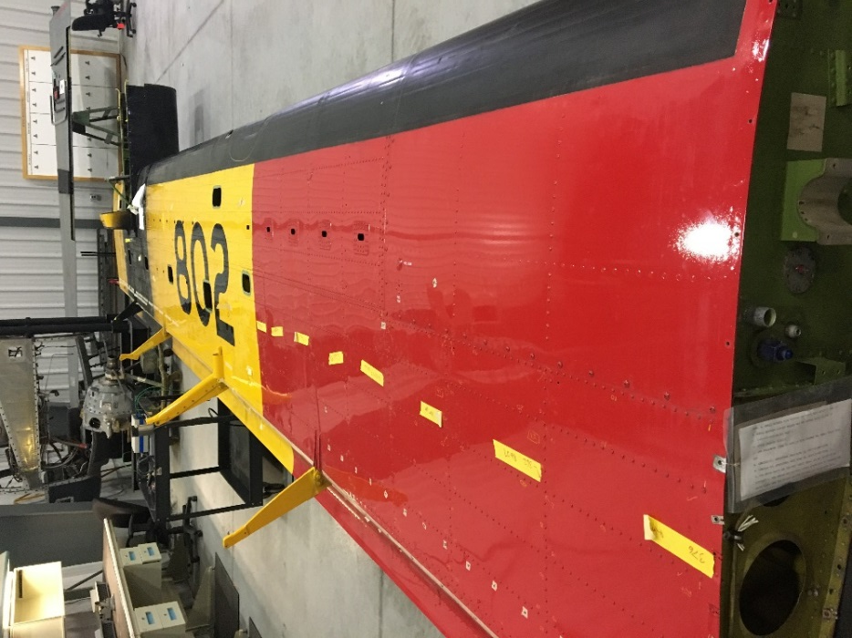
7
Practical Issues
Number fasteners
Check numbering
Data confirmation
Notes:
Sound to check that measurement happened
Positioning system

Slide 8
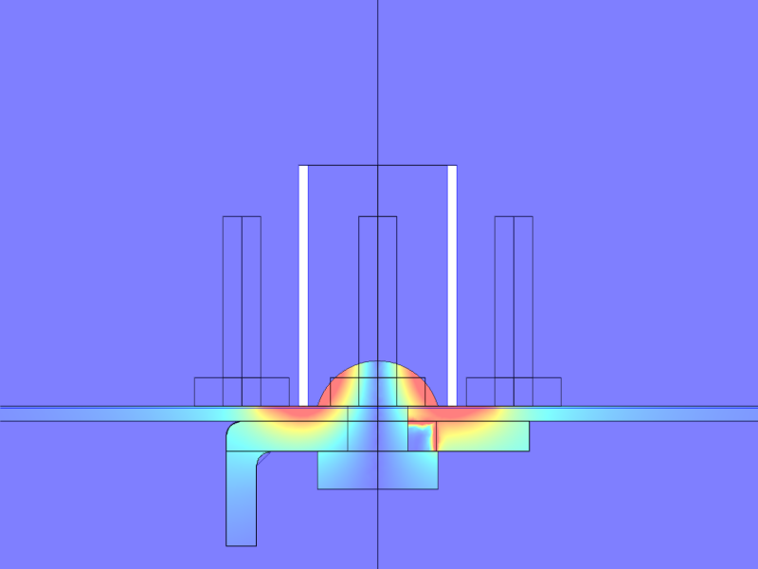
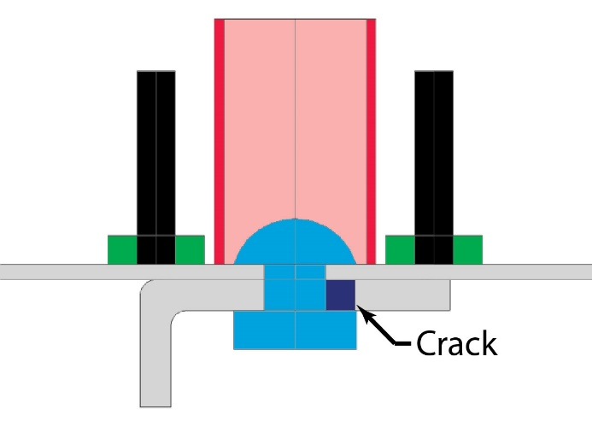
8
Technical Issues

Slide 9
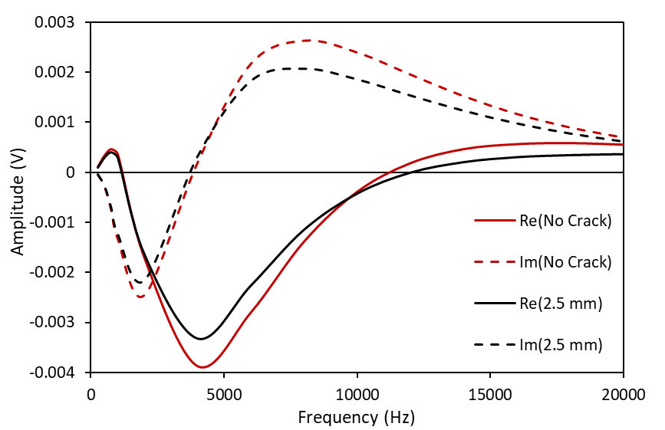
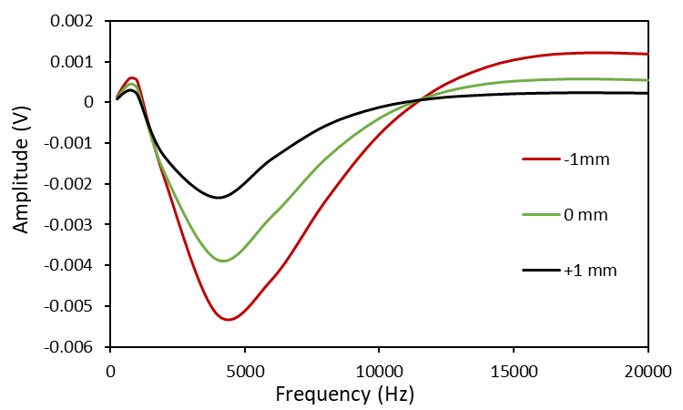
9
Technical Issues
2.5 mm crack
Fastener shift

Slide 10
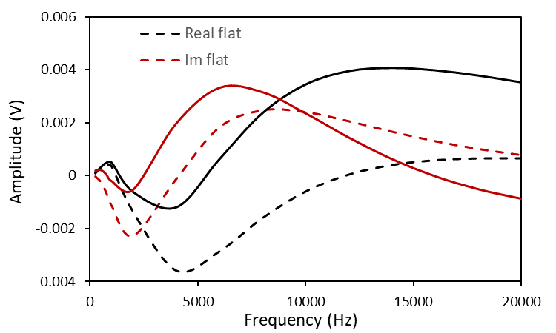
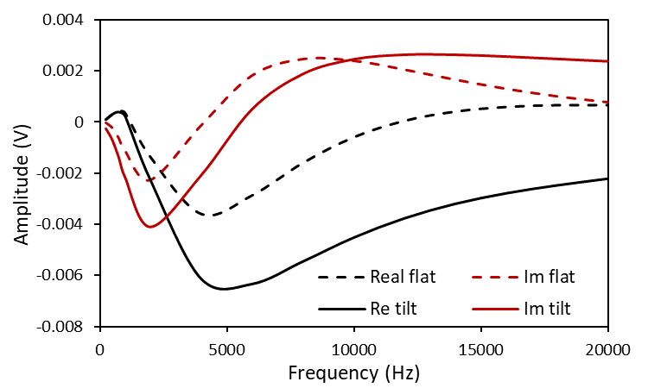
10
Technical Issues
Tilt 2.3° towards edge
Tilt 2.3° along Fasteners

Slide 11
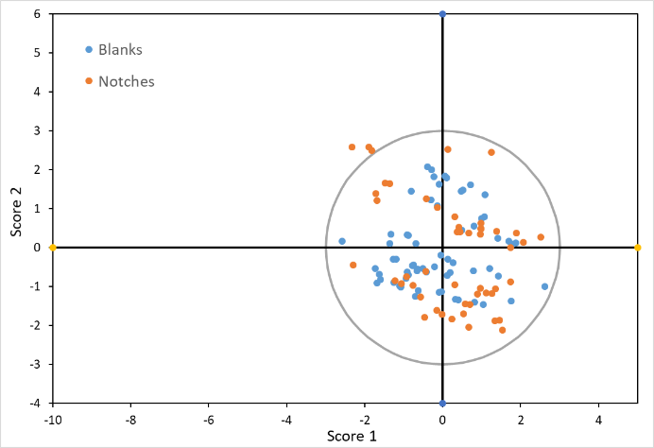
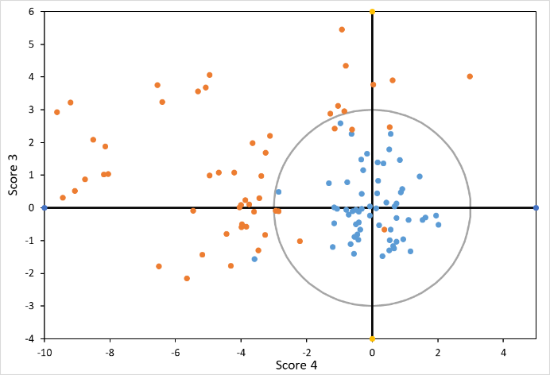
11
Partial Mahalanobis Distance
Scores 1 and 2
Scores 3 and 4

Slide 12
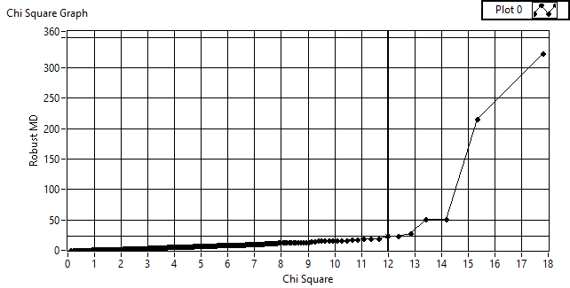
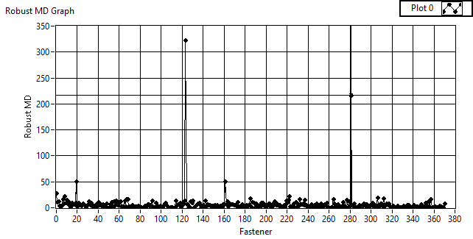
12
Cut-off
(Robust MD)²

Slide 13
13
Sample Size

Slide 14
14
Sample Size
a₉₀
Slope of chi-square

Slide 15
15
Twin Otter Layout
27
26
25
24
23
22
21
20
19
18
17
16
15
14
10
9
8
7
6
5
4
3
2
1

Slide 16
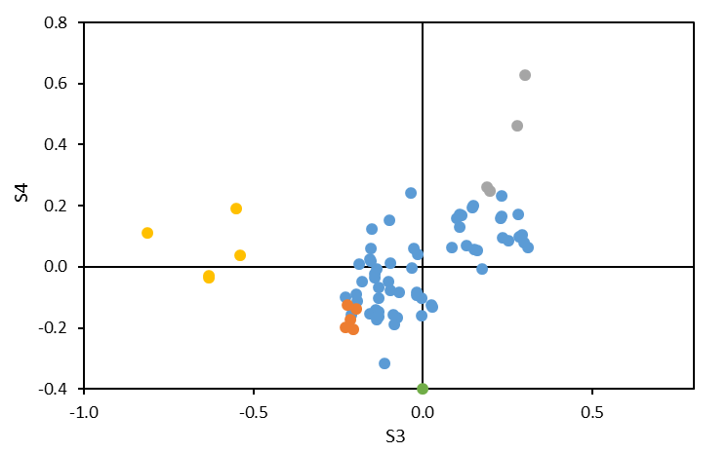
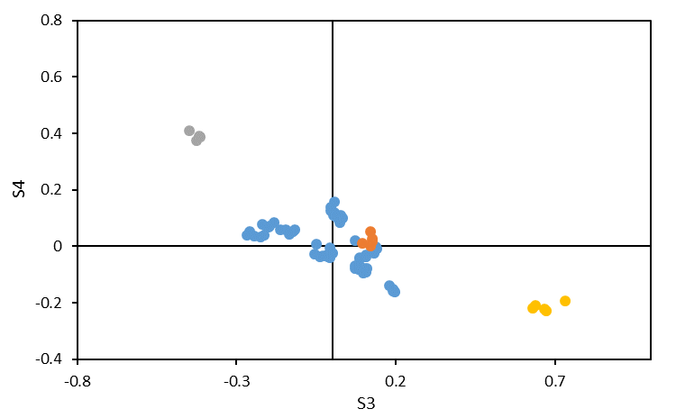
16
Rotation by Repeat Measurement

Slide 17
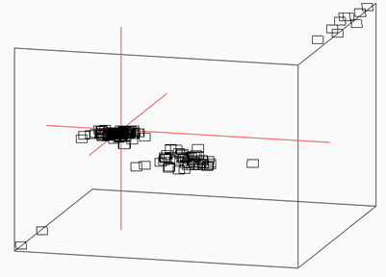
17
3D Visualization

Slide 18
18
Summary
Need methods to link post analysis to fasteners under study
Demonstrated improved methodology for processing measurements
Some repeat measurements are useful to reduce scatter in visualization
Can’t handle isolated fasteners or small groups of fasteners

Slide 19
19
Acknowledgements
ATESS
DTAES

Slide 20
20
Questions?

Slide 22
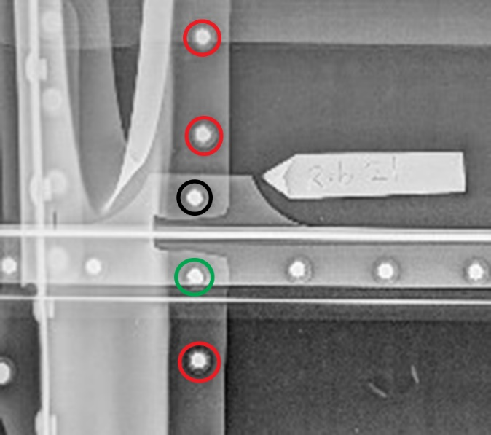
22
Outline

