Slide 1
Detection of damage on a 3D printed beam with a simulated microcrack.
Luis Zumbado, Ed Ginzel, Giovanni Cascante

Slide 2
Outline
Introduction
Microcrack detection on a 3D printed beam
Effect of particle contact density on apparent velocity
Conclusions
References
Acknowledgements

Slide 3
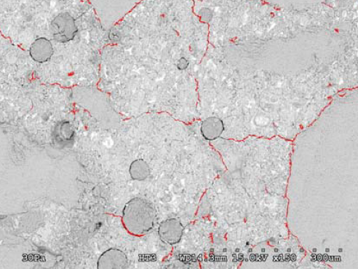
Introduction
Damage in concrete is usually reflected as microcracks.
The ultrasonic parameters are affected by microcracks.
Changes in the ultrasonic parameters can be used to evaluate the presence of damage in the material.
Microcracks formation in concrete (Villavicencio, E., 2006).

Slide 4
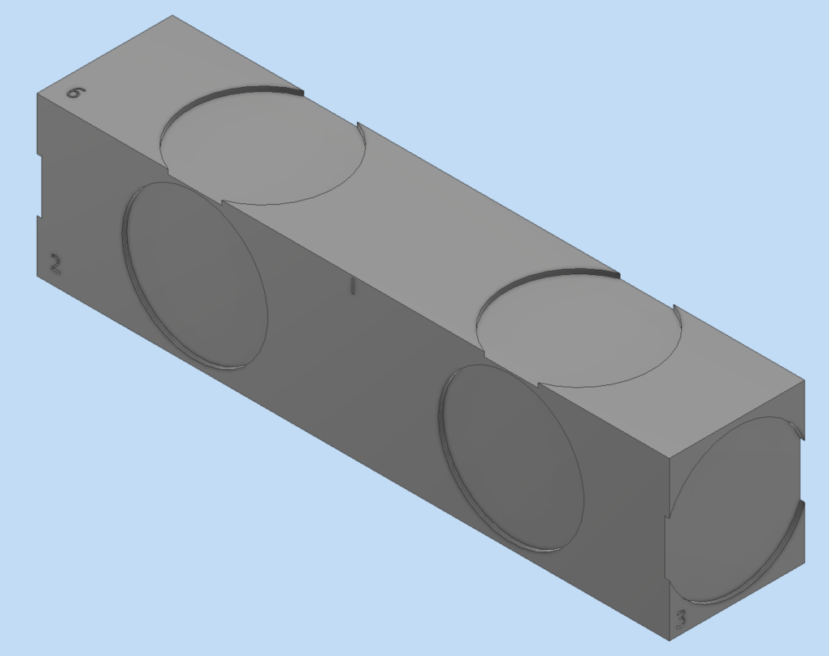
3D printed beam with simulated microcrack
A 3D printed beam with a simulated crack 0.5mm below the surface is used to evaluate the effect of voids and cracking on surface waves.
3D printed beam model.

Slide 5
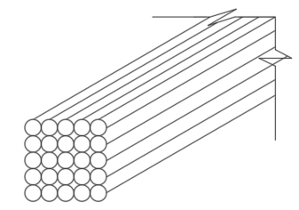
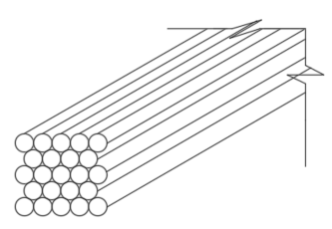
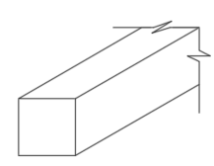
Effect of particle contact density on apparent velocity
Cubic
packing
(4 points of contact)
Hexagonal packing
(6 points of contact)
Two separate setups of glass rods to assess the apparent velocity through a sparsely connected material.
Also, a solid bar of borosilicate glass was used to evaluate the effect of contact density.
Solid
glass

Slide 6
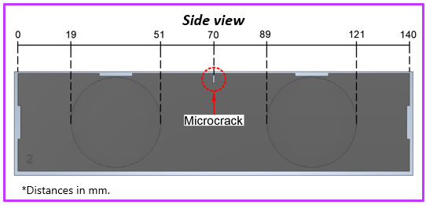
Microcrack detection on a 3D printed beam
PLA filament used to 3D print a beam with a simulated microcrack.
The beam was printed with 100% infill.
Side view of PLA 3D printed beam with microcrack.

Slide 7
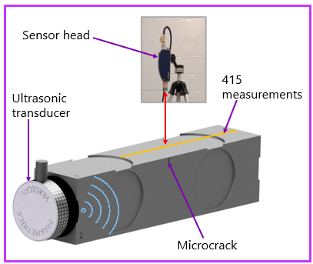
Experimental setup
1MHz Panametrics shear wave transducer.
Polytec OFV-534 laser vibrometer.
Stepper motor-based linear actuator
415 readings were taken (@ 0.2mm).
3D printed beam test setup.

Slide 8
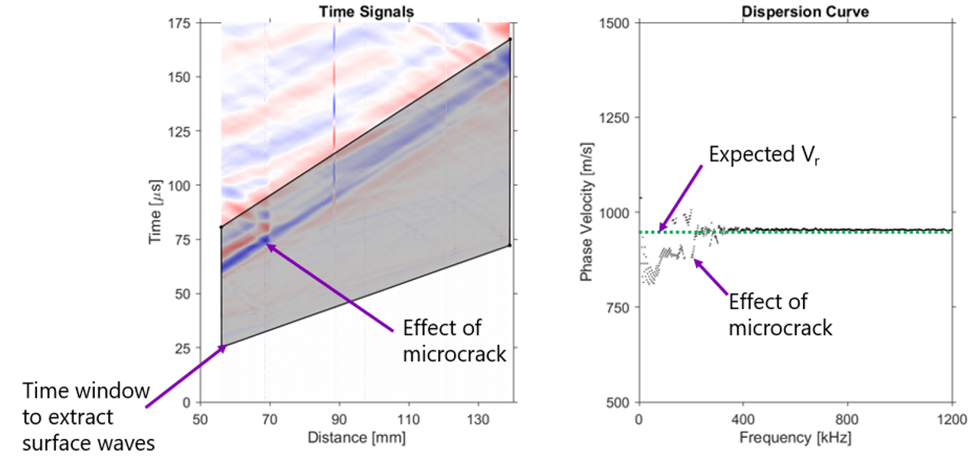
Time signal analysis

Slide 9
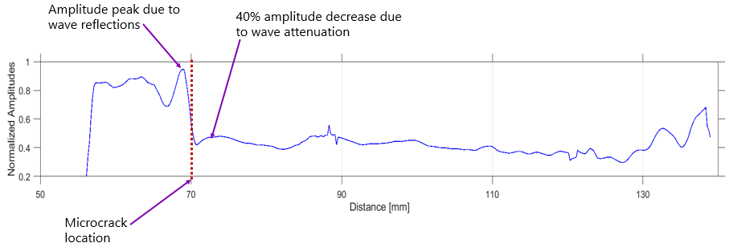
Amplitude analysis

Slide 10
Remarks
Microcrack is visible in the 2D time signal plot.
Microcrack is slightly apparent in the phase velocity dispersion curve plot (15% decrease).
Microcrack is clearly detected in the plot of spectral areas vs distances (40% attenuation of wave amplitude information).

Slide 11
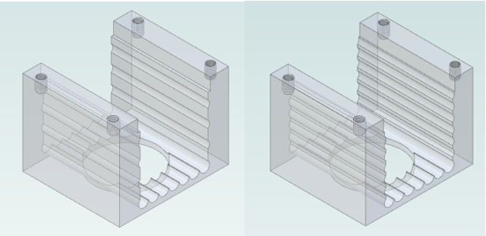
Effect of particle contact density on apparent velocity
3D printed holders for glass rods.
Test on solid bar of borosilicate glass.
Test on arrangement of borosilicate glass rods.

Slide 12
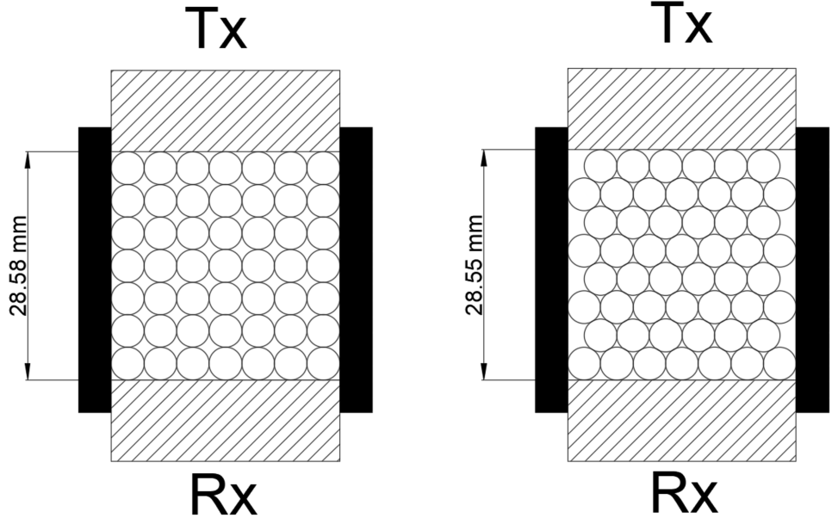
Experimental setup
Tx-Rx face to face.
Rods arranged in two different packings.
Height of the stacks of rods was measured.
A Tx and a Rx probes were placed on either end of the rods.
Time arrival signals were recorded.
Tx: 1MHz UTX (low damping) and 1MHz Panametrics
Rx: 1MHz Panametrics

Slide 13
Summary of tests
Sample | Transmitter | Abbreviation
Solid glass (25mm) | 1MHz Panametrics | SG / PAN / PAN
Solid glass (25mm) | 1MHz UTX (low damping) | SG / UTX / PAN
Glass rods (cubic packing) | 1MHz Panametrics | CUB / PAN / PAN
Glass rods (cubic packing) | 1MHz UTX (low damping) | CUB / UTX / PAN
Glass rods (hexagonal packing) | 1MHz Panametrics | HTC / PAN / PAN
Glass rods (hexagonal packing) | 1MHz UTX (low damping) | HTC / UTX / PAN

Slide 14
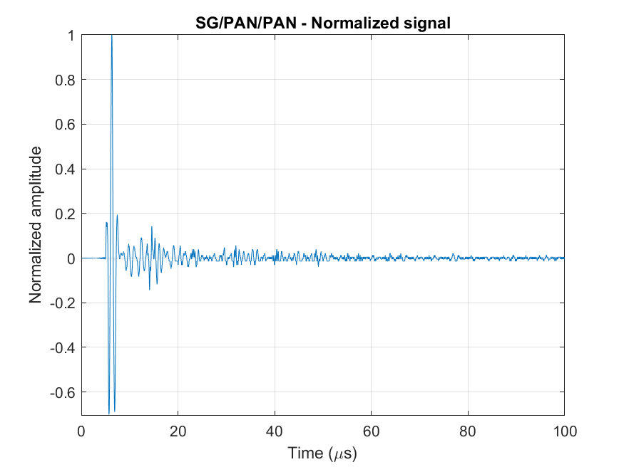
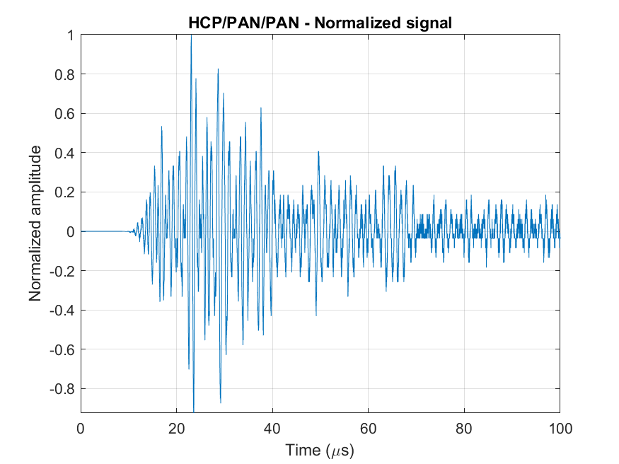
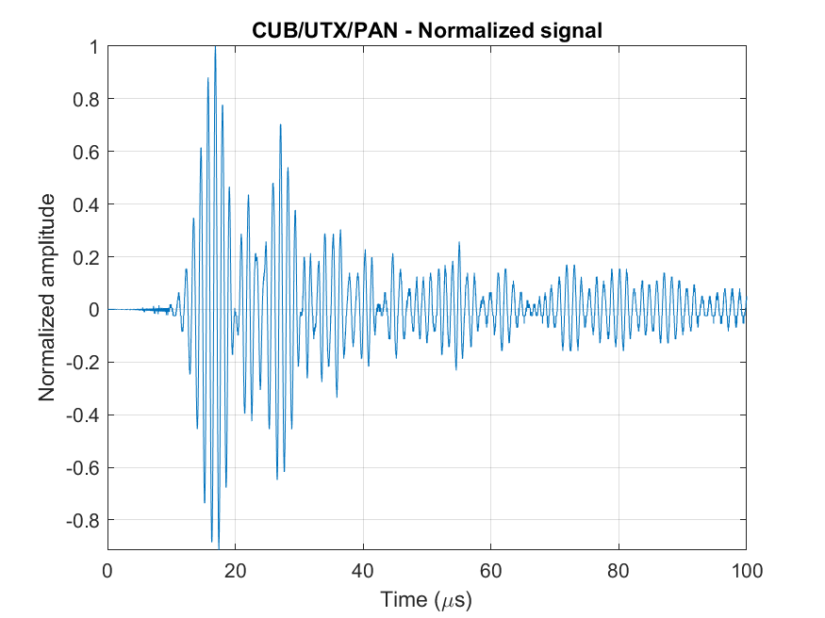
Normalized time signals from tests
Solid glass
Glass rods with hexagonal packing
Glass rods with cubic packing

Slide 15
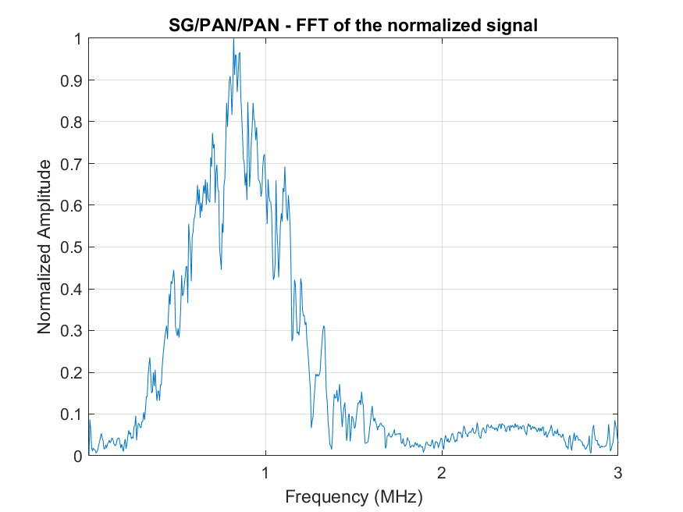
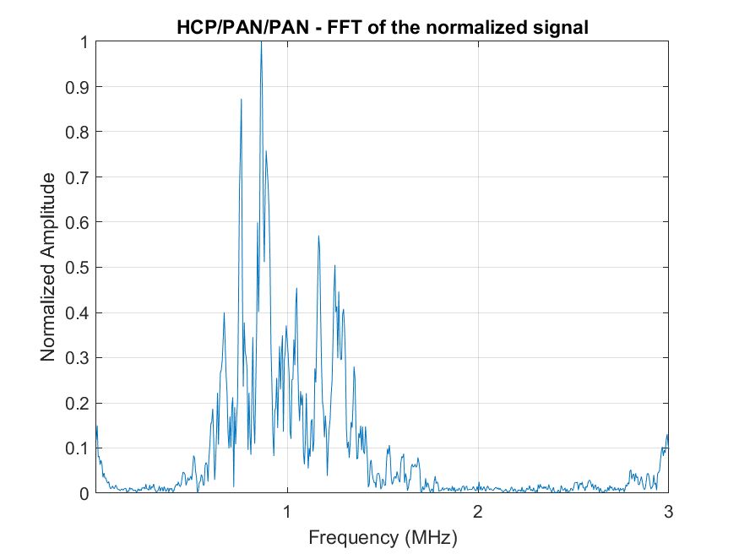
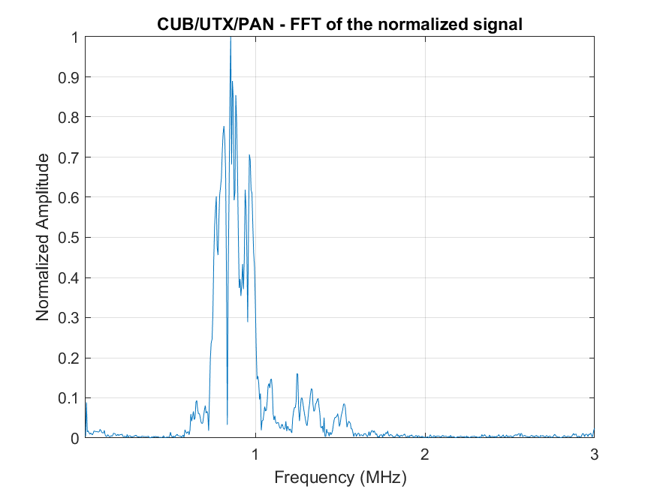
Normalized FFTs from tests
Solid glass
Glass rods with hexagonal packing
Glass rods with cubic packing

Slide 16
Results
Arrival times and apparent velocities from tests on different material configurations.
Test | Arrival time (µs) | Velocity (m/s) | Velocity reduction with respect to solid glass test (%)
SG / PAN / PAN | 4.41 | 5074.8 | N/A
SG / UTX / PAN | 4.31 | 5192.6 | N/A
CUB / PAN / PAN | 9.69 | 2949.4 | 41.9
CUB / UTX / PAN | 8.73 | 3273.8 | 37.0
HTC / PAN / PAN | 9.05 | 3154.7 | 37.8
HTC / UTX / PAN | 8.37 | 3884.4 | 25.2

Slide 17
Remarks
Acoustic apparent velocity of the ultrasonic pulse on the compression mode is much slower for the glass rods arrangement than the solid glass (25.2% - 41.9%).
There is a small but noticeable difference between the apparent velocity obtained from the hexagonal and cubic packing arrangements (7% -16%).

Slide 18
Conclusions
The 3D printed beam with a simulated microcrack test is suitable for damage detection with surface – waves.
When a material is not consolidated and has minimal points of contact with its neighbours the apparent velocity decreases.

Slide 19
References
1. INTERNATIONAL ATOMIC ENERGY AGENCY, Guidebook on Non-destructive Testing of Concrete Structures, Training Course Series No. 17, IAEA, Vienna (2002).
2. Malhotra VM, Carino NJ. Handbook on Nondestructive Testing of Concrete. 2nd ed. CRC Press; 2004.
3. Richart, F. E., Hall, J. R., & Woods, R. D. (1970). Vibrations of soils and foundations. (N. M. Newmark, Ed.) Prentice-Hall.
4. Schreiner, M., Matija Strlič, and Renzo Salimbeni. 2008. Handbook on the use of lasers in conservation and conservation science. Brussels, Belgium: COST Office.
5. SpringerLink (Online service), Tomasini, E. P., & Castellini, P. (2020). Laser Doppler Vibrometry: A Multimedia Guide to its Features and Usage (1st ed. 2020.). Springer Berlin Heidelberg : Imprint: Springer.

Slide 20
Acknowledgements
The Natural Science and Engineering Research Council of Canada (NSERC), the Ontario Centres of Excellence, the Ministry of Transportation of Ontario, (MTO), for their financial support; and to Mr. Ed Ginzel for his strong support to our research group.

Slide 21
Thank you!

Slide 22
Detection of damage on a 3D printed beam with a simulated microcrack.
Luis Zumbado, Ed Ginzel, Giovanni Cascante

