Slide 1
NDE 4.0 in Body-in-White Vehicle Assembly Process
R. Gr. Maev*, A.M. Chertov*, D. Stocco*, M. Rodzik**, J. Chamberlain**
*Institute for Diagnostic Imaging Research, Windsor, ON
** The Narmco Group

Slide 2
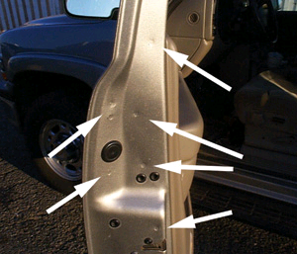
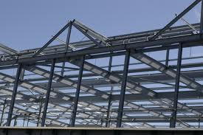
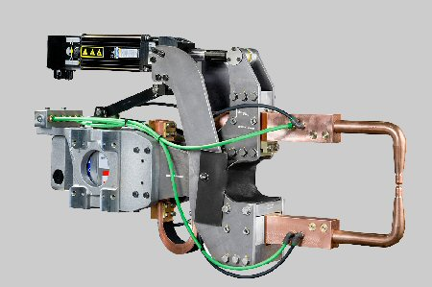
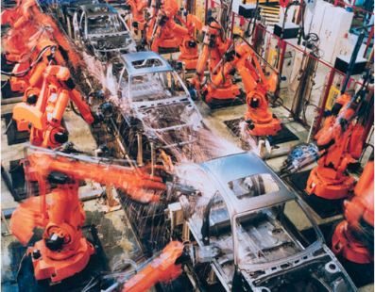
Resistance Spot Welding in Industry
Regular vehicle contains 4000-6000 spot welds
Spot welding is highly automated today.
So it has to be inspected regularly.

Slide 3
What is the Future of Spot Welding?
“Without question, the dominant joining technology in automotive construction today is resistance spot welding. A typical body-in-white constructed today contains as many as 6000 resistance spot welds. A recent automotive roadmap suggests that trend is not likely to change any time soon.”
Gould, J. E. (Edison Welding Institute)
Welding Research
01 2012, V. 91 pp. 23-s to 34-s

Slide 4
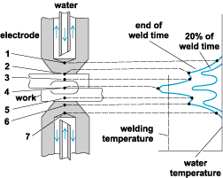
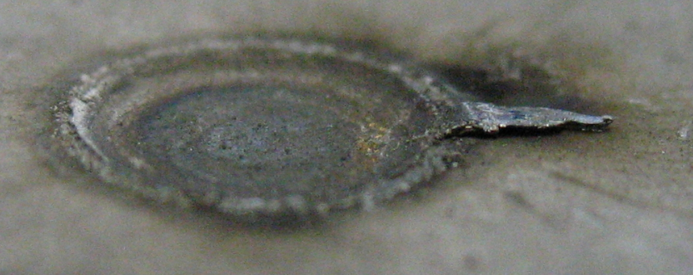
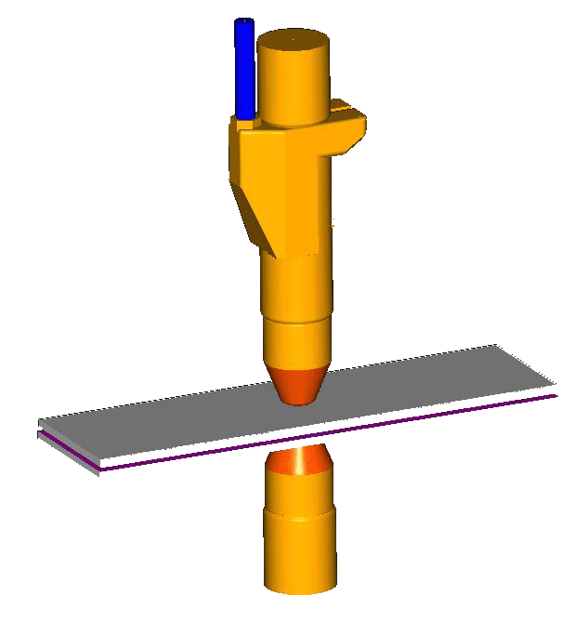
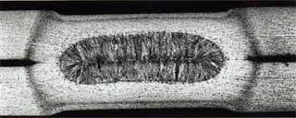
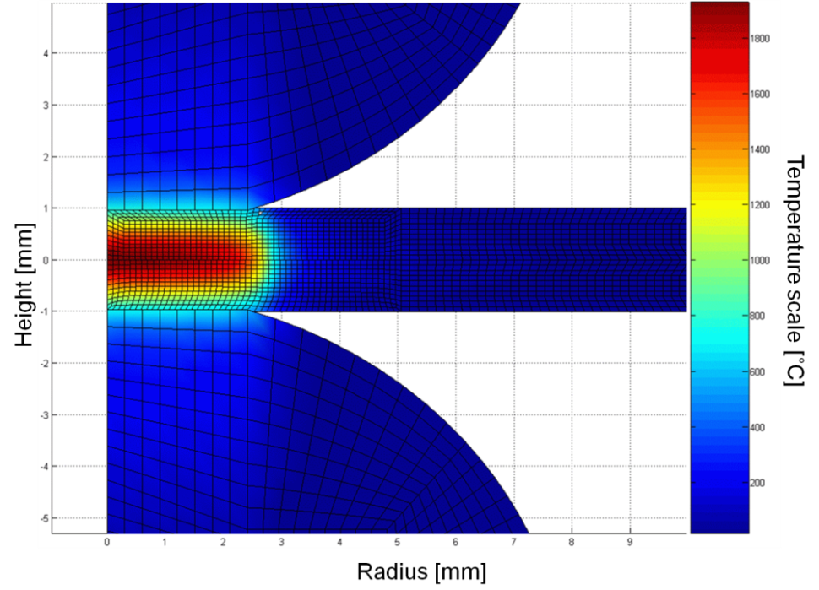
Spot Welding
Outside (top) and inside (bottom) look of spot weld
Spot welding involves
electrode forces: 500..2200 lb
electric currents: 5000..13000 A
temperatures: 20..2000 C
Some means of quality control are required to ensure uninterrupted automatic production.
4

Slide 5
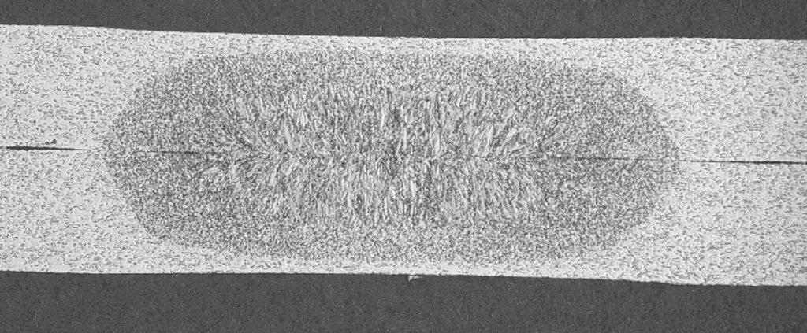
Destructive Testing
Peel test Cross-section
Cons: Selective testing; Time consuming; Labour intensive.
More than 99% of the parts are never checked. For this reason, at the design stage, additional spot welds are introduced into the assembly process.
5
5

Slide 6
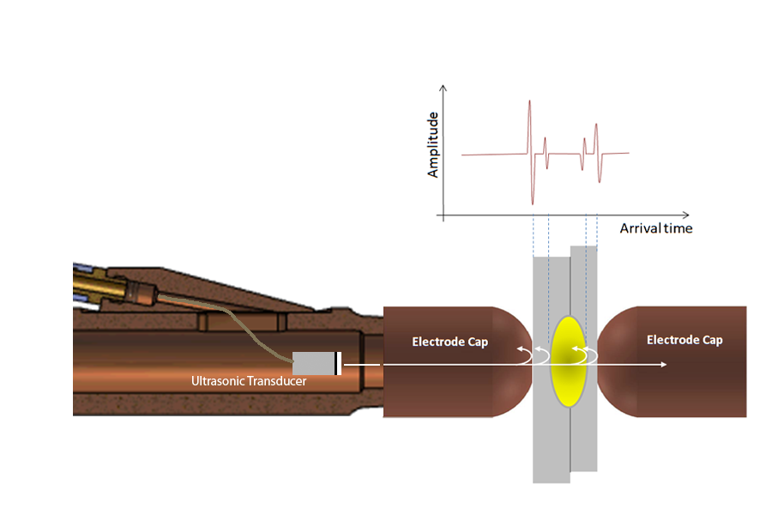
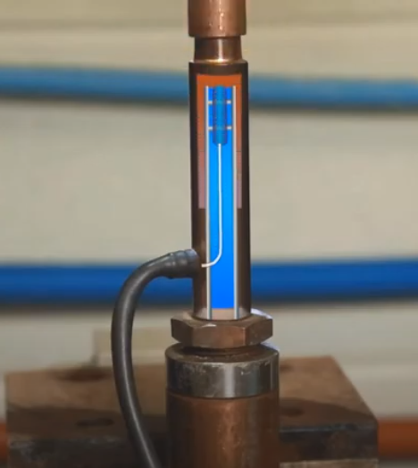
Testing Configuration
Ultrasonic wave is sent by the ultrasonic transducer positioned in the cooling water stream. Reflections from the stack boundaries and nugget tell whether the base metal is melted or not.
6

Slide 7
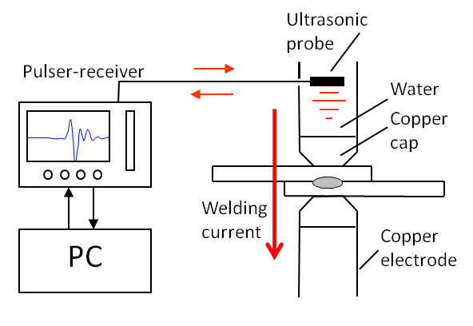
Non-destructive Testing
Potential to inspect 100% of produced welds
When steel plates are heated, the sound speed drops from 5900 m/s at room temp. down to 4200 m/s at melting point and down to 3900 m/s in liquid state.
steel
steel
7

Slide 10
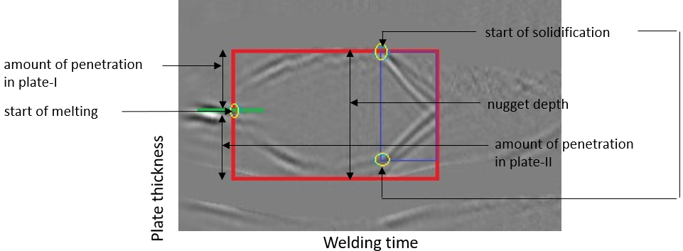
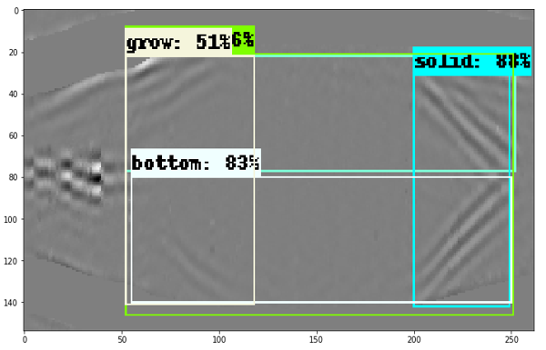
Matching Weld Geometry with Ultrasonic Measurements using AI
Calculate parameters from coordinates obtained by Deep Learning and match them with real weld geometry

Slide 11
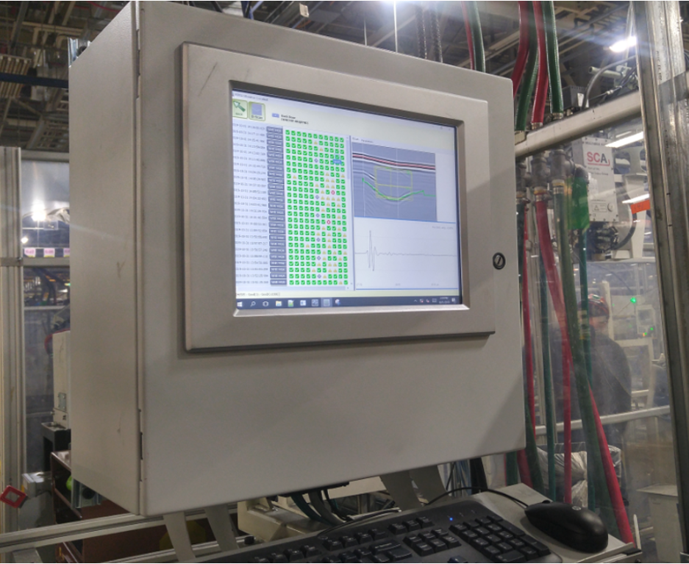
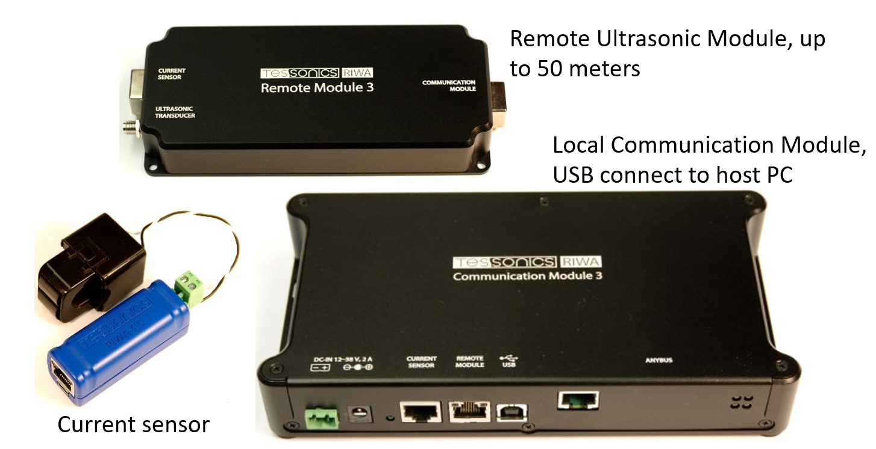
The Hardware

Slide 12
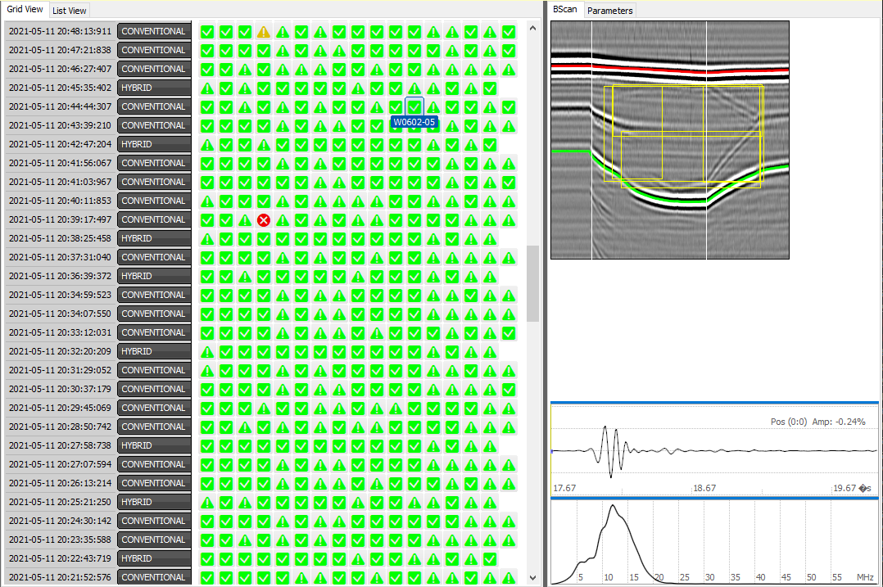
Production Data Example
Every horizontal row of tags represents welds on one part.
RIWA can get Weld ID and Part ID from the robot and break the welds into parts or logical groups of welds.

Slide 13
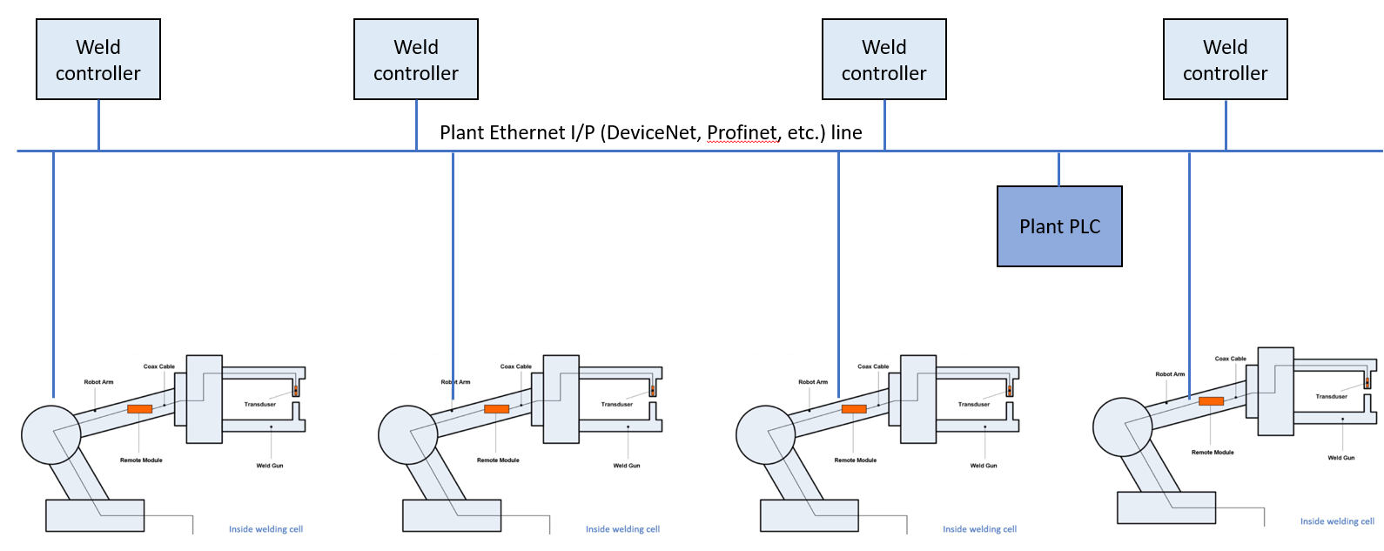
Welding Cell with Multiple Robots

Slide 14
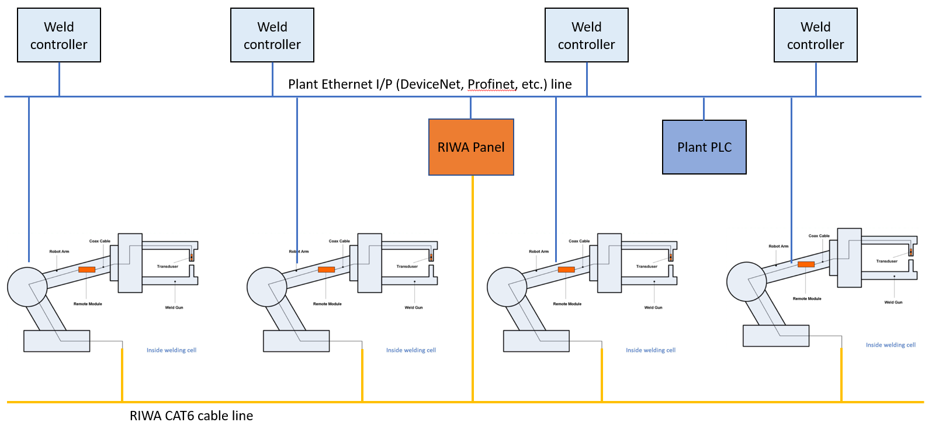
Welding Cell with Multiple Robots and Networked Ultrasonic Testers

Slide 15
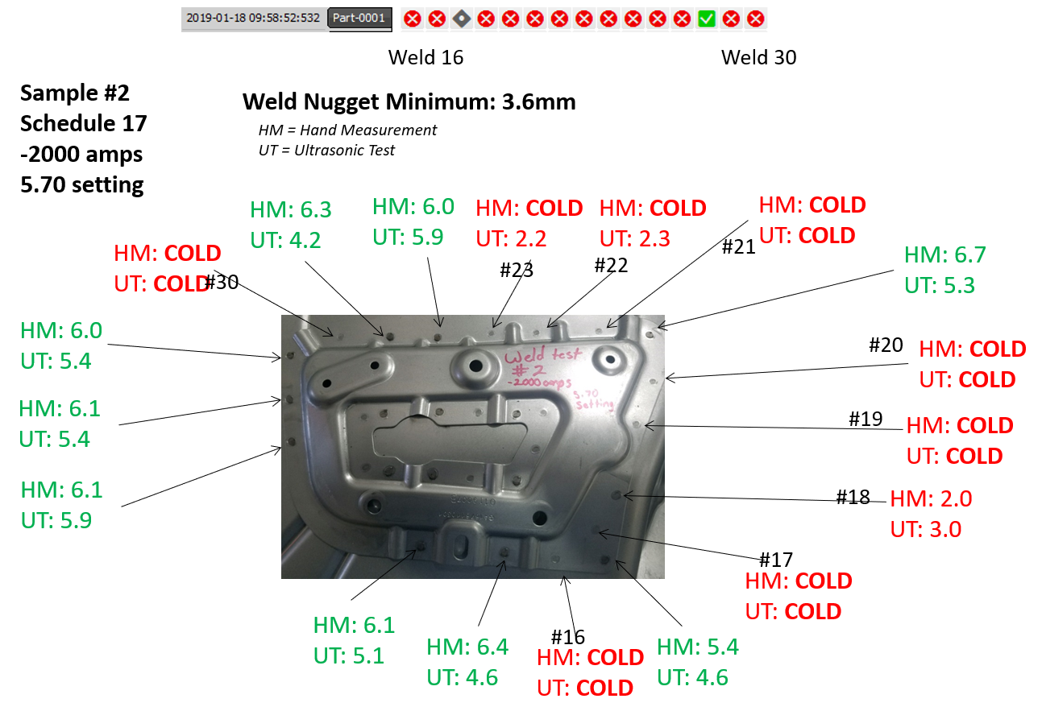

Slide 16
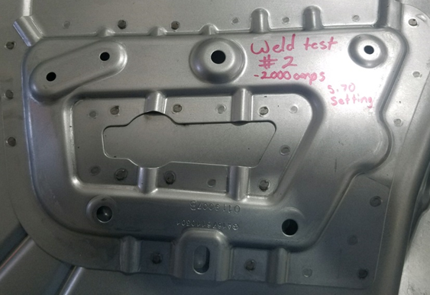

Slide 20
Plant-wide Aggregation of the Assembly Process Quality Data

Slide 21
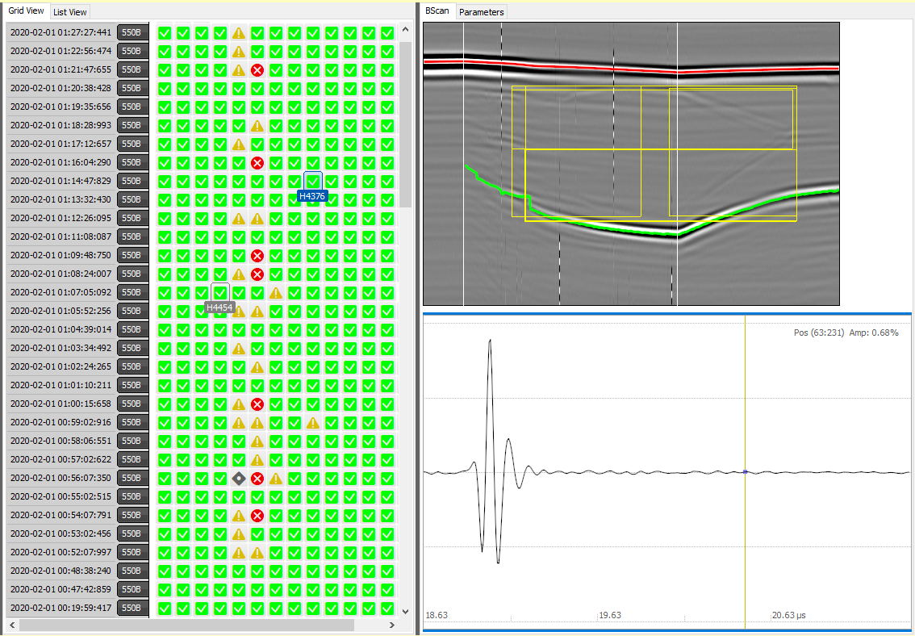
Quality Status Displayed in Real Time
Example of Graphical Representation of Weld Monitoring in Production
Trends in weld quality can easily be spotted

Slide 22
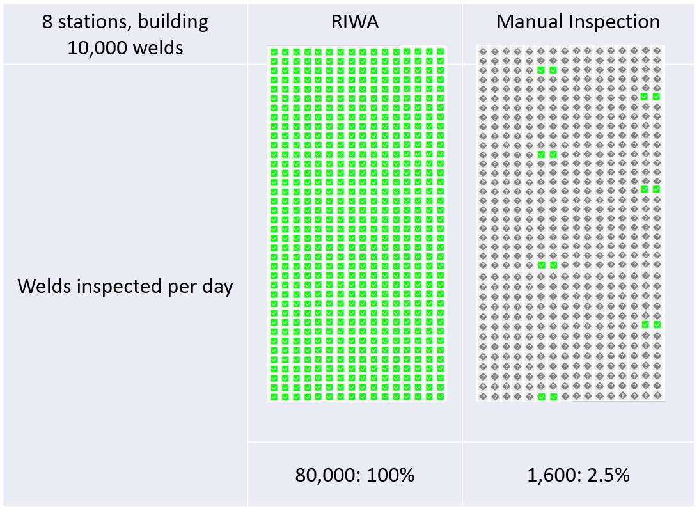
Automated Inspection of 100% of Welds vs Manual Inspection

Slide 23
Conclusions
AI-driven automation of quality inspection reduces costs on scrap, maintenance and manual selective inspections
Real-time quality characterization and process monitoring
Operator-independent
Data analysis allows determine trends and predict certain failure modes
Quality data can be saved for long-term potential use (life of the product)

